Slide 1
Introduction to Minnesota Obsolete Bank Notes & Scrip
R. Shawn Hewitt
Northwest Coin Club
February 14, 2019

Slide 2
Minnesota Obsoletes
Historical context
Ways to collect obsoletes
Home in on Minnesota

Slide 3
Background
Evolution of U.S. Paper Money

Slide 4
Early U.S. Paper Money
Colonial Currency
1690 – 1780s
Bills of Credit
Issued to finance government and/or military campaigns
Floated in value against gold and silver
Counterfeiting very problematic
Notes:
Massachusetts was the first to issue. Fiat money. Could be secured by land, as in the case of Pennsylvania. But generally not redeemable except for payment of taxes.

Slide 5
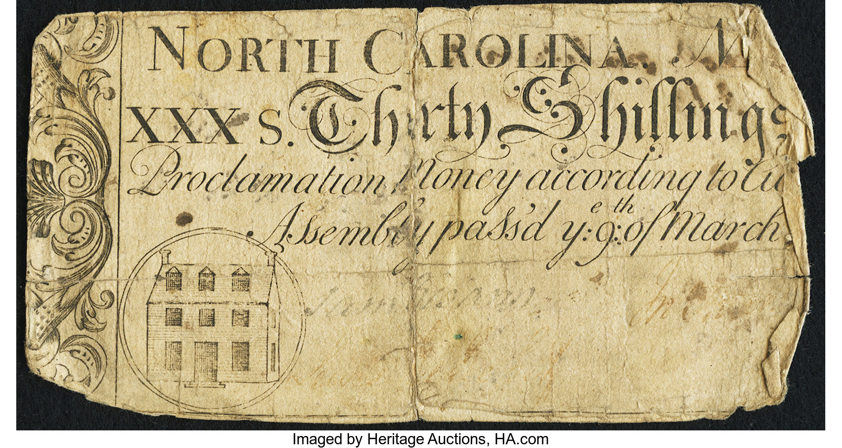
Early U.S. Paper Money
Notes:
My ancestors used in 18th century North Carolina. Simple designs led to counterfeiting…

Slide 6
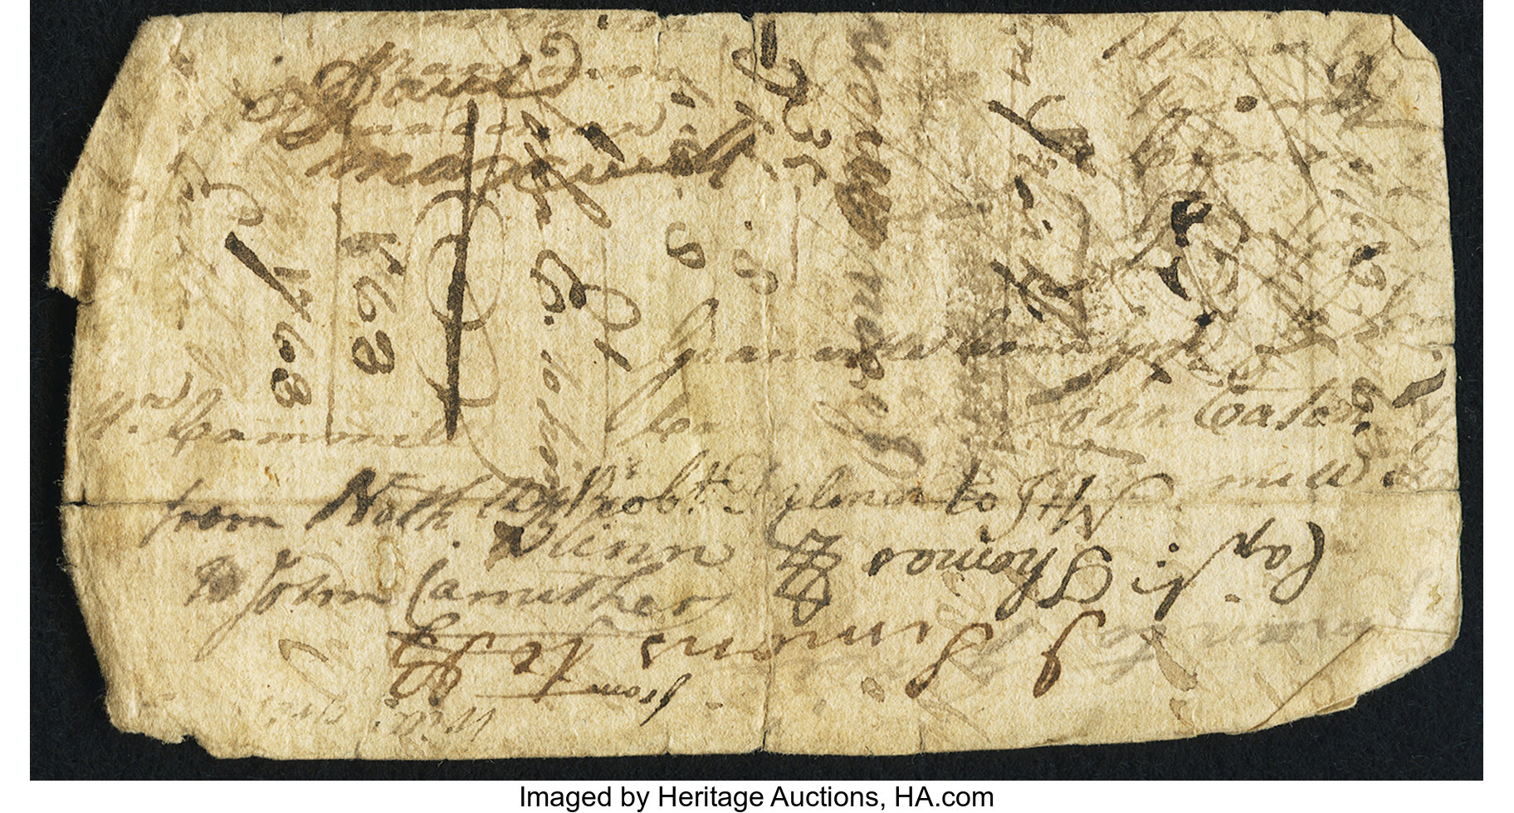
Early U.S. Paper Money
Notes:
So much so that when you spent a note, it was customary to write your name on the back in case it was later discovered to be fake.

Slide 7
Early U.S. Paper Money
Continental Currency
1775 – 1780s
Denominations ranged from $1/6 to $80
Issued to finance the Revolutionary War
Counterfeited by the British

Slide 8
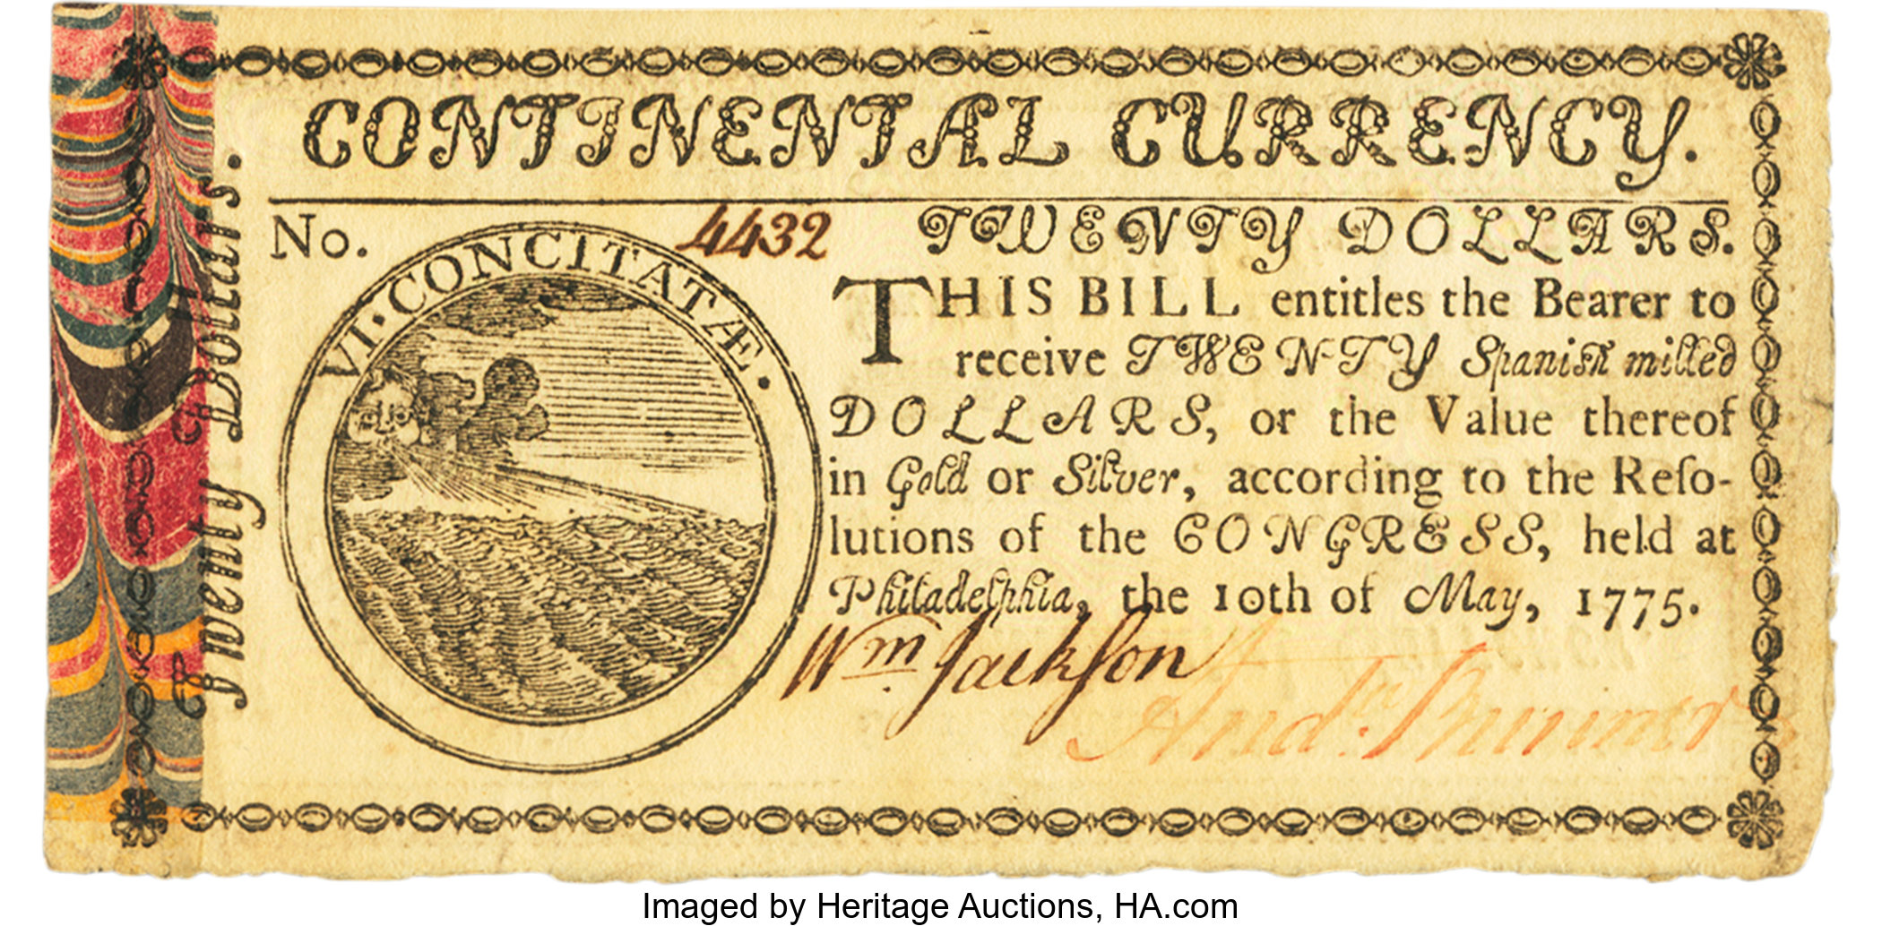
Early U.S. Paper Money
Notes:
Marbled edge.

Slide 9
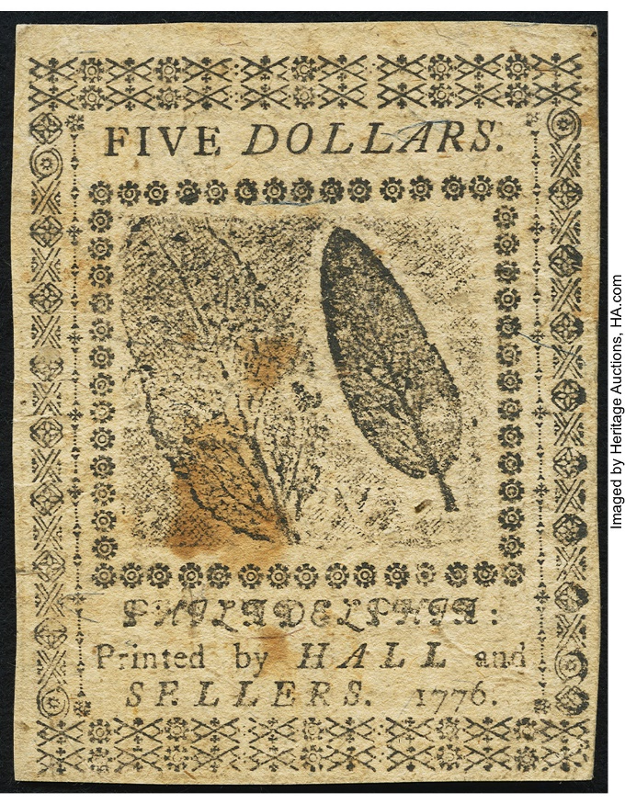
Early U.S. Paper Money
Notes:
Nature print.

Slide 10
Early U.S. Paper Money
Continental Currency
Over-issuance led to severe depreciation
By 1778 they lost 80% of their value
By 1780 they lost 97%
Ultimately, exchanged for Treasury bonds at 1%
“Not worth a continental”
Prohibitions on issuance at Federal and State level
Notes:
Constitutional Convention prohibited states from issuing bills of credit. Articles of Confederation abolished the Federal Government of issuing bills of credit.
States and Federal government were out of the note issuing business.

Slide 11
Obsolete Note Era
Banking for a growing country

Slide 12
Obsolete Note Era
The Obsolete Note Era
1782 – 1865
Several private issues
Scrip
Notes:
War is over. Nation gets down to business.

Slide 13
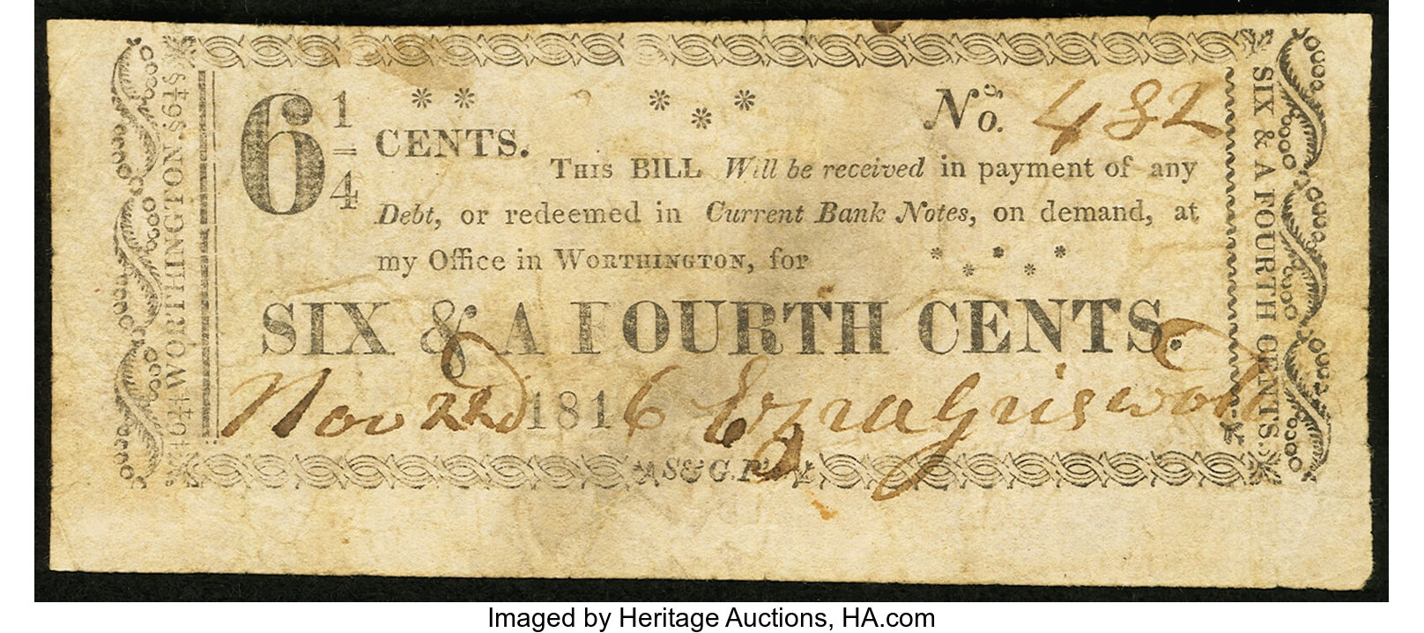
Private Issues

Slide 14
Obsolete Note Era
The Obsolete Note Era
1782 – 1865
Several private issues
Scrip
States wrote their own banking laws (State Banking)
Chartered banking
Free Banking

Slide 15
Chartered Banking
Chartered Banks
Had to get approval from the state
Some engaged in a non-bank activity
Authority to issue notes
Redemption terms?

Slide 16
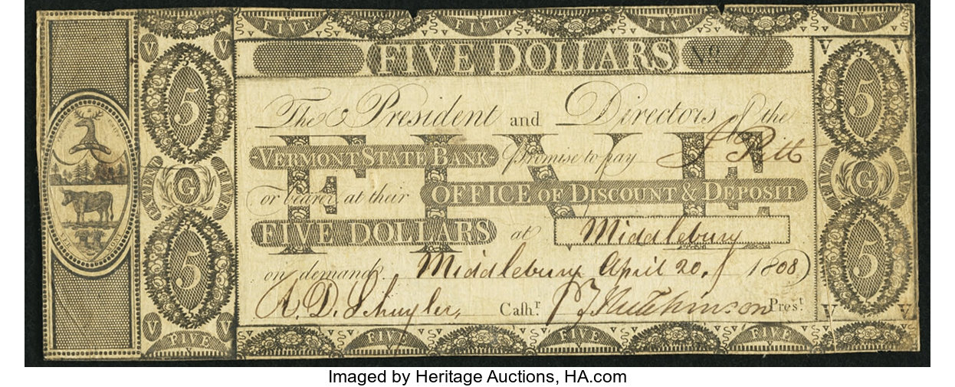
Chartered Bank Note
Notes:
Note how the technology has improved over colonial issues.

Slide 17
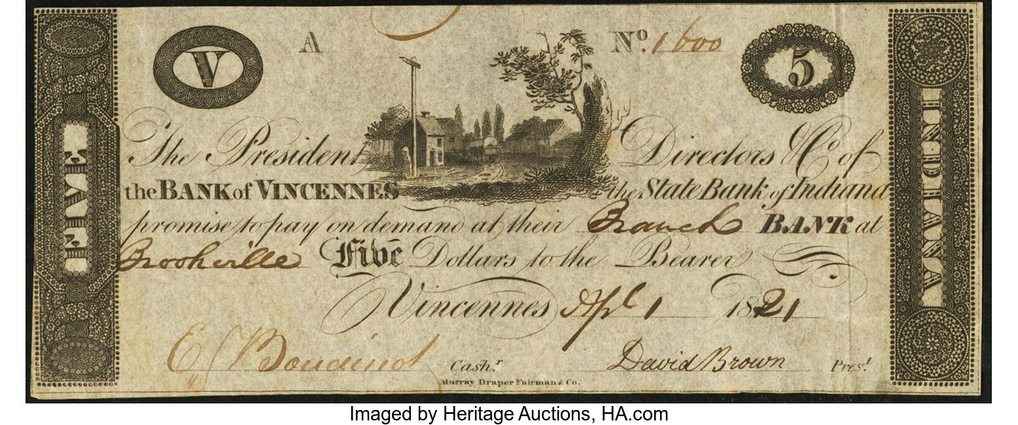
Chartered Bank Note

Slide 18
Free Banking
Free Banking Era
1837 – 1865
Anyone could organized a bank with sufficient capital
Redeem notes in specie on demand
Michigan 1837
Poor note holder protections
Notes backed by real estate
Wildcat banking
New York 1838
Strong protections for note holders
Notes backed by state bonds on deposit with state authority
Stable system

Slide 19
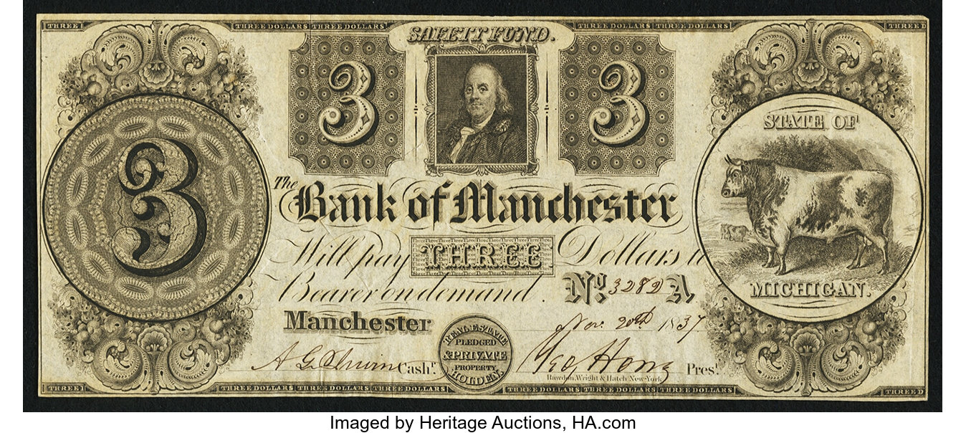
Free Bank Note
Notes:
Secured by real estate.

Slide 20
Problems with State Banking
System had its problems
Lots of different bank’s notes in circulation
Different backing
Is a $1 bank note worth a dollar in coin?
Counterfeiting
Bank Note Reporters

Slide 21
Private Issues
Scrip or shinplasters
General prohibited
Issued mostly during crises
Coins hoarded
To facilitate trade
States took over and issued their own during crises

Slide 22
End of Obsolete Bank Note era
Civil War bought about changes
U.S. needed to finance war
Demand Notes 1861
Legal Tender Notes 1862
National Banking Act 1863
Nationalized banking using U.S. bonds
One central regulator
Uniform currency
Taxed state bank notes 1865

Slide 23
Collecting Obsoletes
You’re only limited by your imagination (and budget)

Slide 24
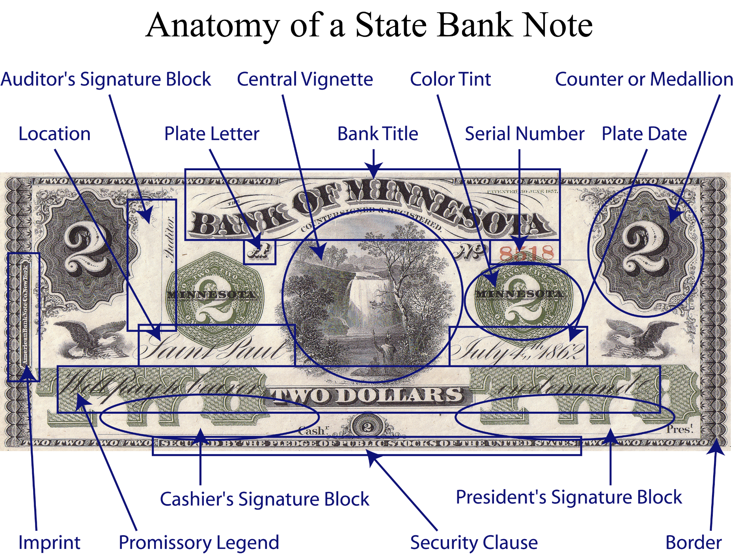

Slide 25
Collecting Obsoletes
Lots of ways to collect
History
Vignettes and artwork
Notes:
These are the props of history.

Slide 26
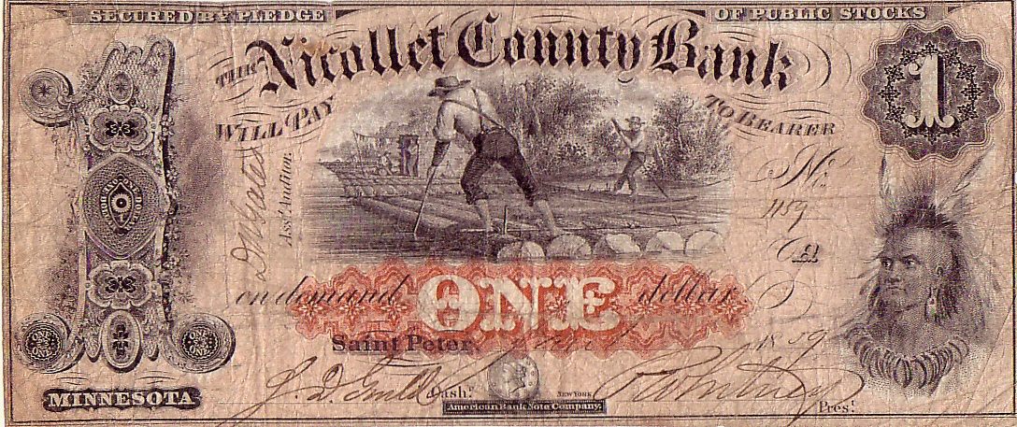
Vignettes
Notes:
Indians. St. Peter massacre in 1862.

Slide 27
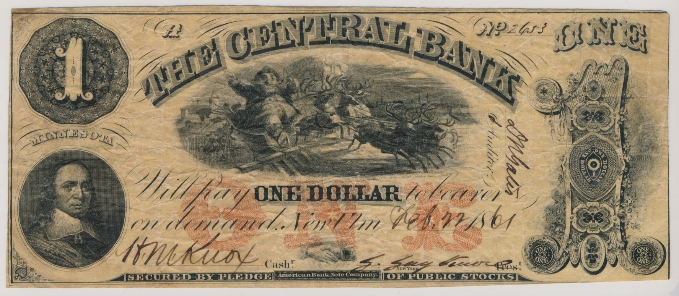
Vignettes
Notes:
Most ambitious way to collect by vignette: Santa Claus

Slide 28
Collecting Obsoletes
Lots of ways to collect
History
Vignettes and artwork
Denominations

Slide 29
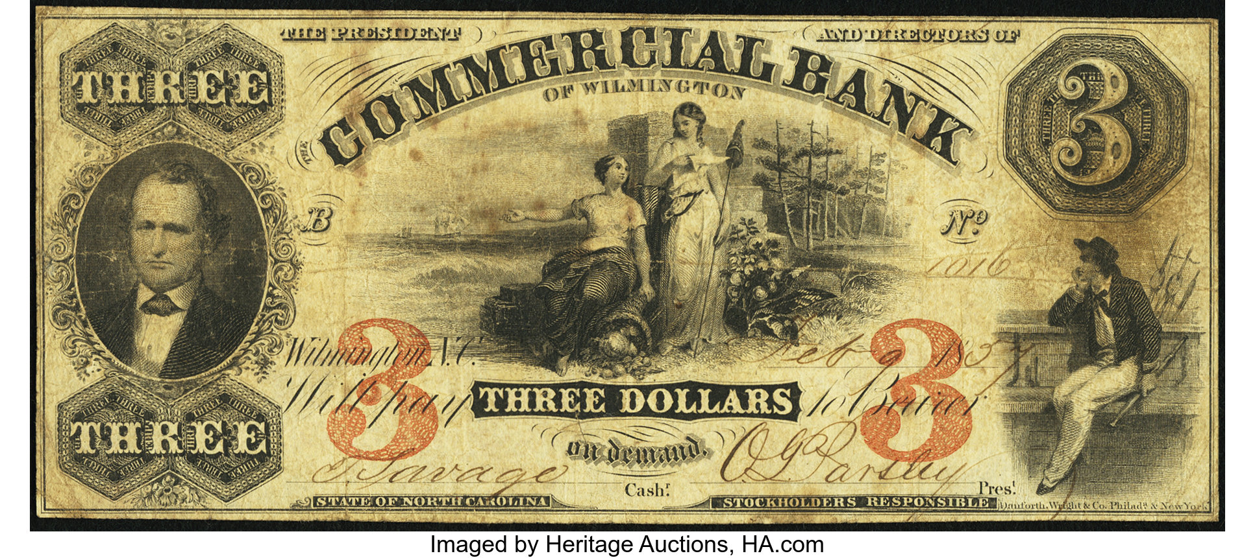
Denominations

Slide 30
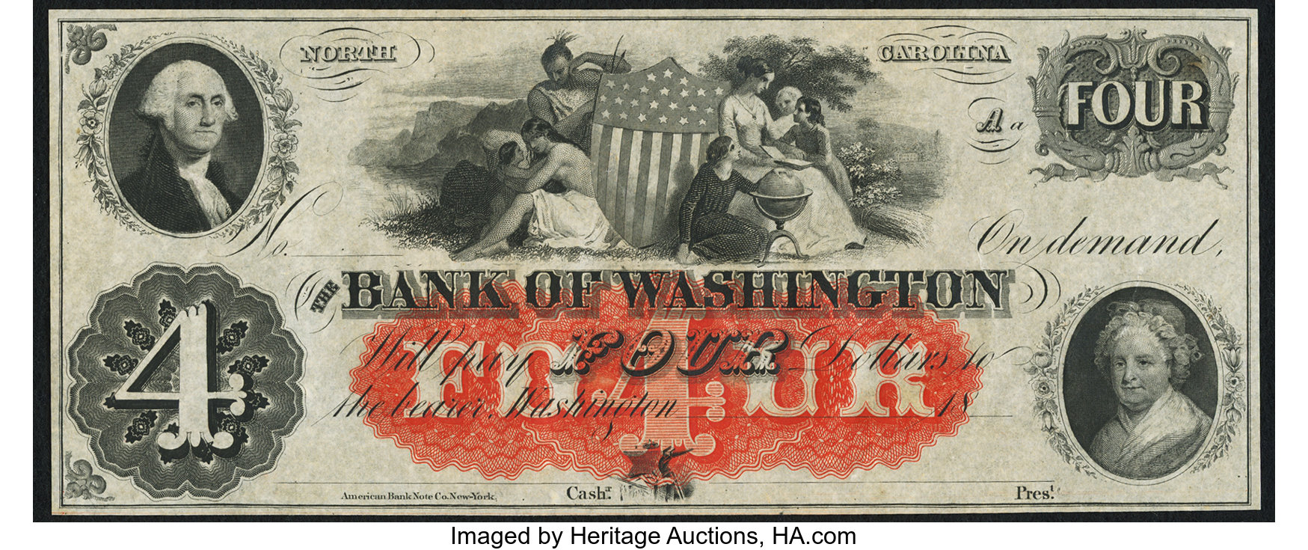
Denominations

Slide 31
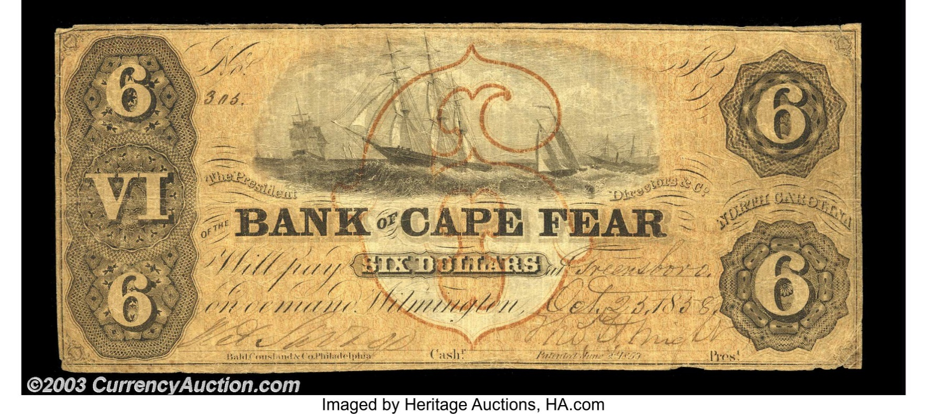
Denominations

Slide 32
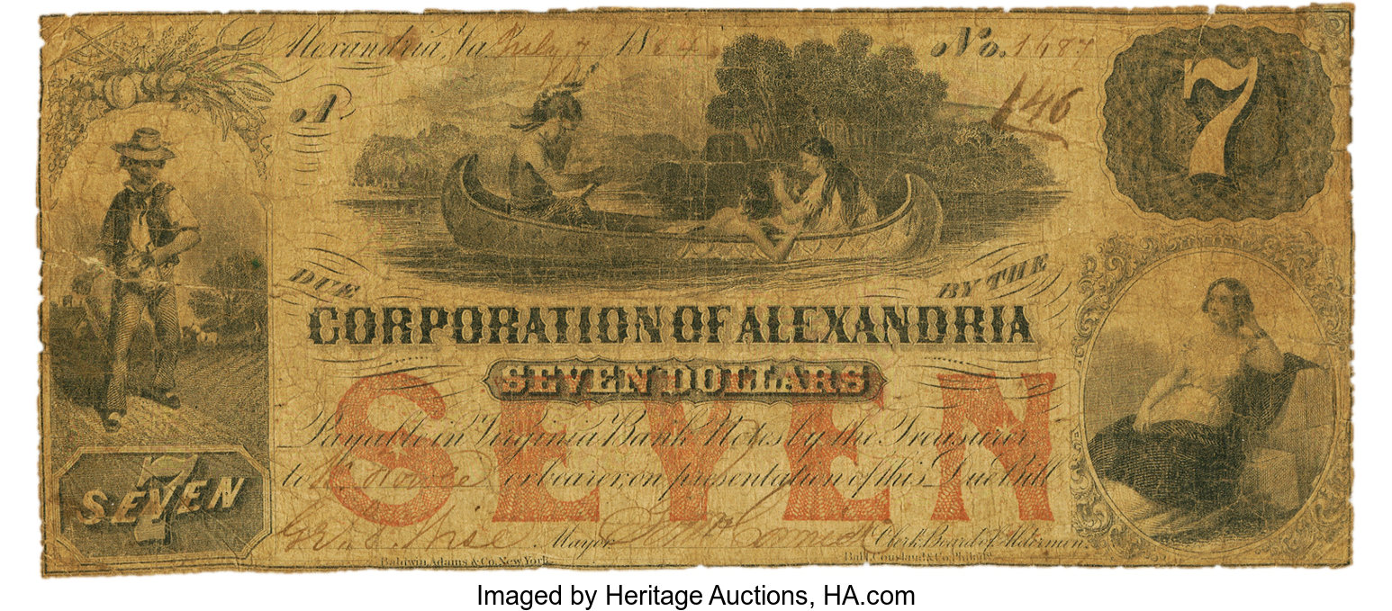
Denominations

Slide 33
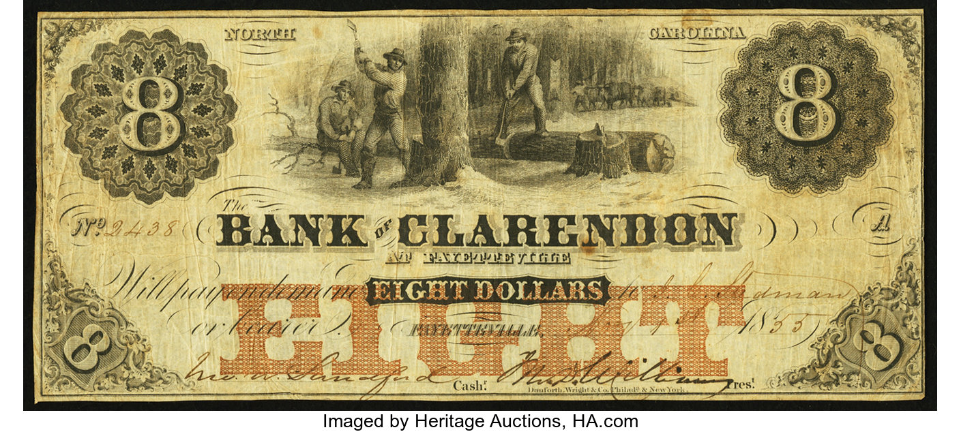
Denominations

Slide 34
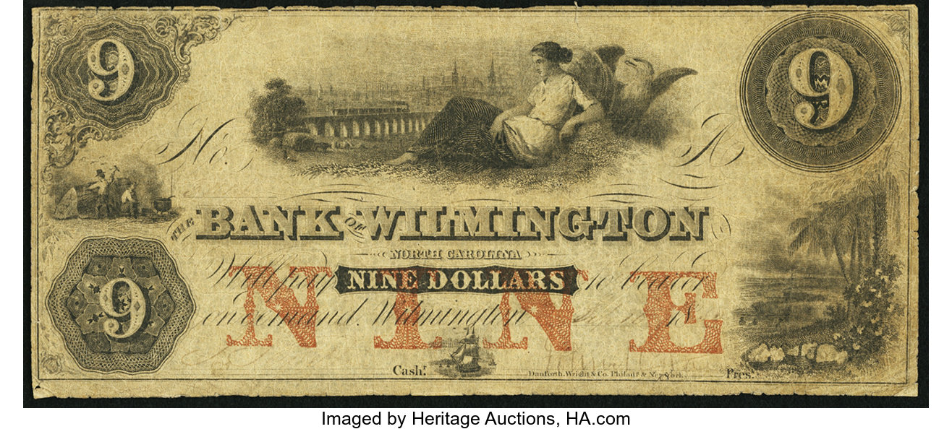
Denominations

Slide 35
Collecting Obsoletes
Lots of ways to collect
History
Vignettes and artwork
Denominations
Signers

Slide 36
Signers

Slide 37
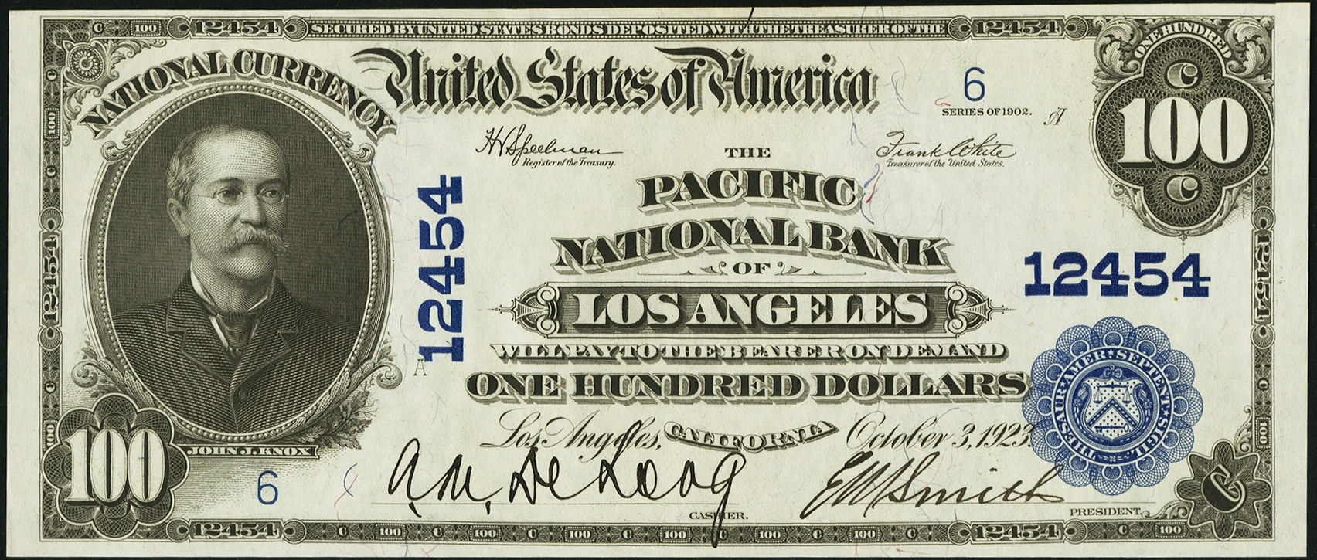
John Jay Knox

Slide 38
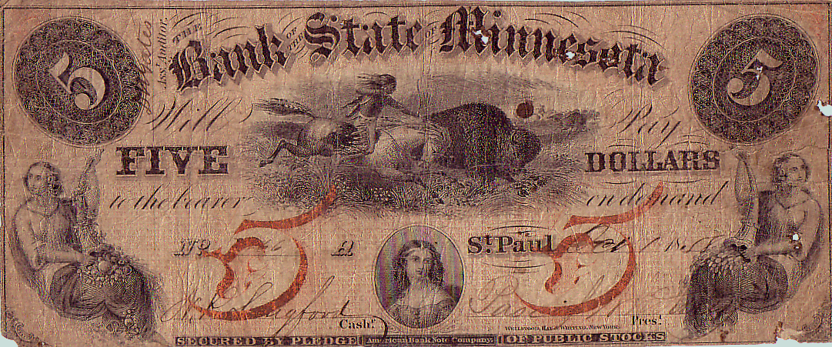
Singers
Notes:
The first bank to open. N. P. Langford was cashier. He became the first superintendent of Yellow Stone National Park.

Slide 39
Collecting Obsoletes
Lots of ways to collect
History
Vignettes and artwork
Denominations
Signers
Geographically
Places you’ve been
Home

Slide 40
Collecting Obsoletes
Proofs

Slide 41
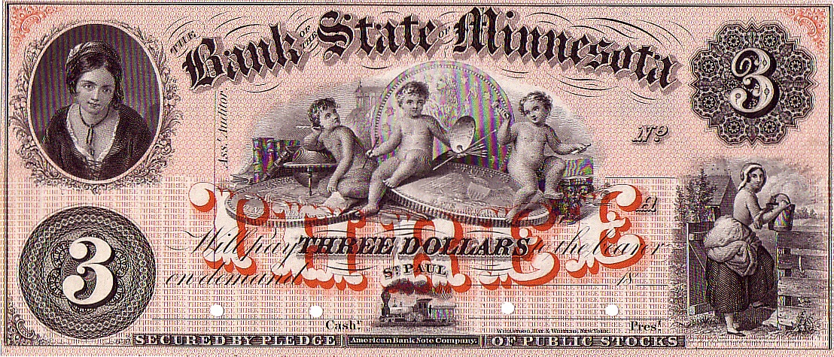
Proofs

Slide 42
Collecting Obsoletes
Proofs
Issued Notes

Slide 43
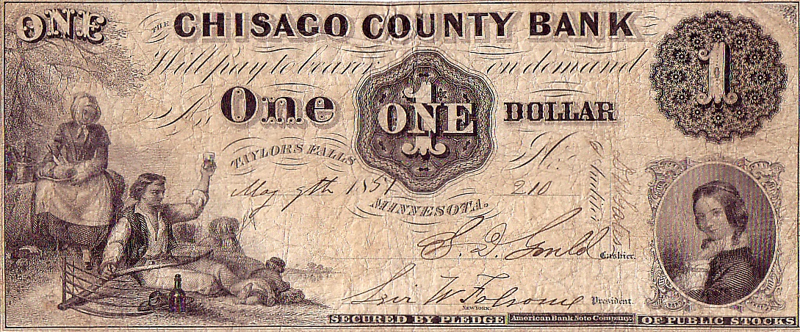
Issued Notes

Slide 44
Collecting Obsoletes
Proofs
Issued Notes
Remainders

Slide 45
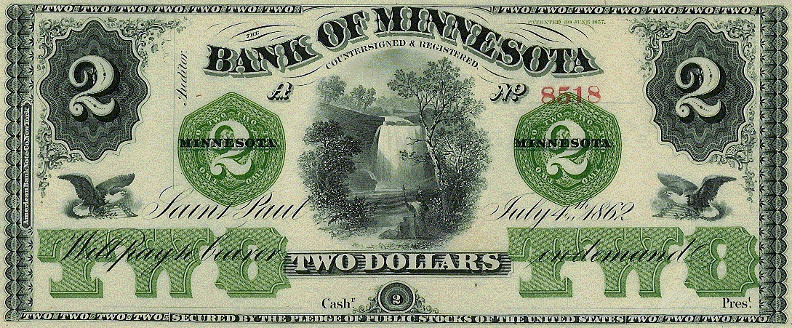
Remainders

Slide 46
Collecting Obsoletes
Proofs
Issued Notes
Remainders
Condition

Slide 47
Minnesota Experience
A rough start

Slide 48
Minnesota Experience
Minnesota Territory
Early legislature prohibited note issue
Bank of Saint Croix

Slide 49
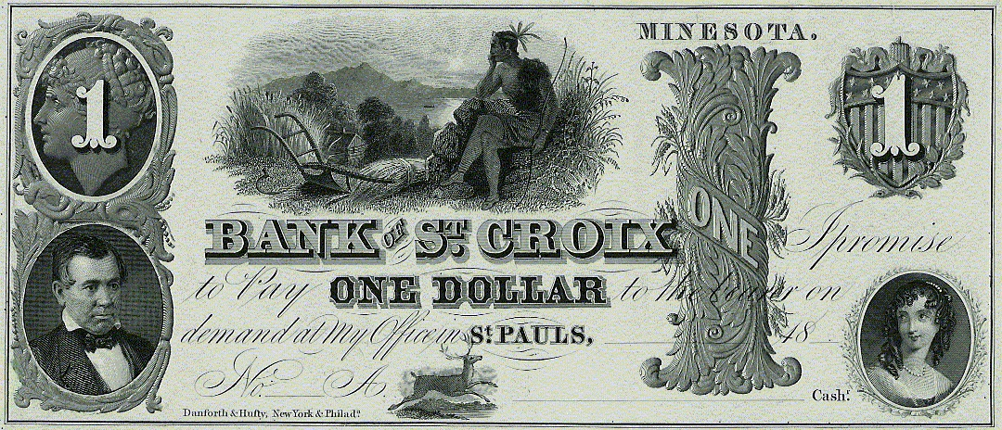
Bank of Saint Croix
Notes:
Isaac Young, a leather-worker from Cincinnati.
Very talented at his craft. Won many awards.
Get a contract to make mail pouches for U.S. post office.
Sold his business, moved west, with a vision in mind.
He wanted to open a bank. How hard can that be?
Has these notes engraved. Sought support from some powerful individuals in Minnesota government. He was impatient. Went ahead and floated some of these notes in St. Louis.
He was virtually run out of the territory.
Left his wife and family behind, moved to Memphis.
Where he issued these.

Slide 50
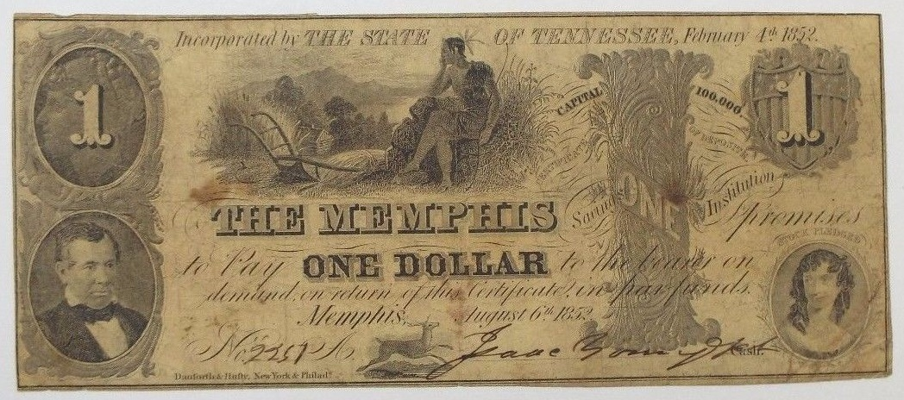
Reincarnated

Slide 51
Minnesota Experience
Minnesota Territory
Early legislature prohibited note issue
Bank of Saint Croix
Borup & Oakes

Slide 52
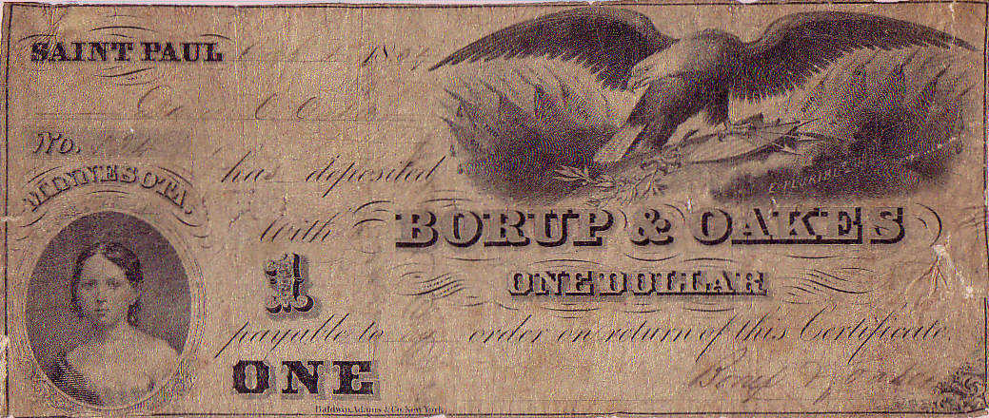
Borup & Oakes
Notes:
Borup & Oakes were legitimate, respected bankers. This is the earliest known issued note from Minnesota Territory. Their effort did not last long.

Slide 53
Minnesota Experience
Minnesota Territory
Early legislature prohibited note issue
Bank of Saint Croix
Borup & Oakes
Fraudulent Issues

Slide 54
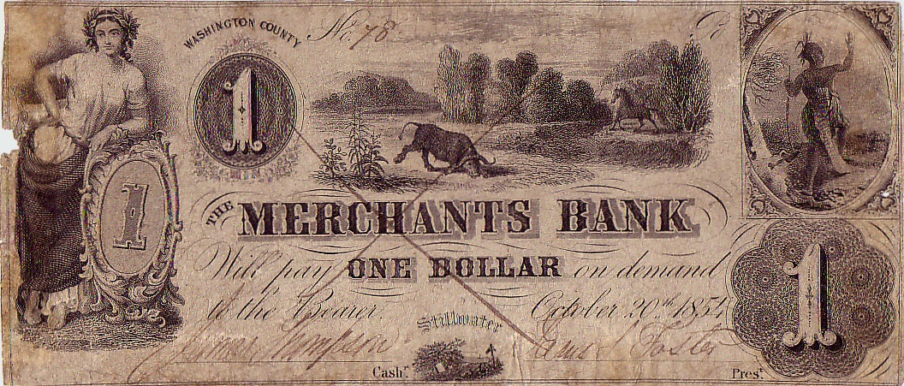
Fraudulent Issues
Notes:
Unscrupulous individuals created this, probably floated this spurious issue somewhere out east. When that no longer worked, they changed the plate…

Slide 55
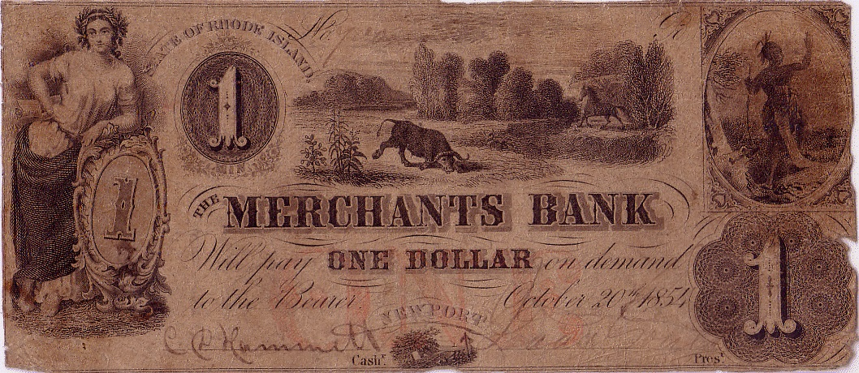
Fraudulent Issues

Slide 56
Minnesota Experience
Minnesota Territory
Early legislature prohibited note issue
Bank of Saint Croix
Borup & Oakes
Fraudulent Issues
Endorsed Notes

Slide 57
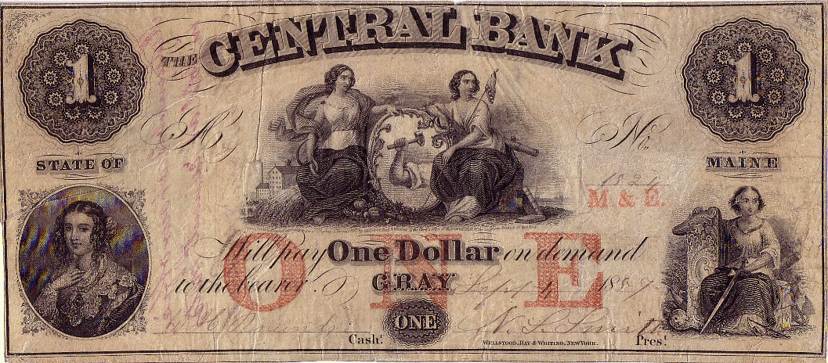
Endorsed Notes
Notes:
Local bankers were creative.

Slide 58
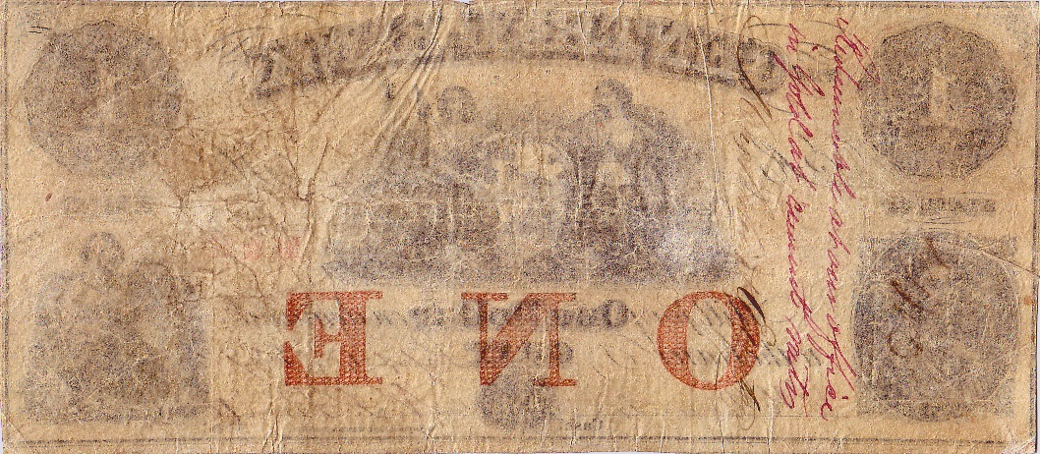
Endorsed Notes
Notes:
Redeemable at our office in gold at current rates.

Slide 59
Minnesota Experience
Minnesota Territory
Early legislature prohibited note issue
Bank of Saint Croix
Borup & Oakes
Fraudulent Issues
Endorsed Notes
State Notes

Slide 60
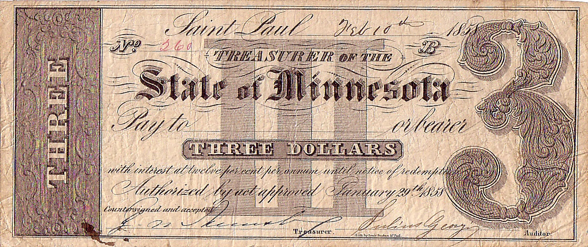
State of Minnesota
Notes:
Dated before statehood.

Slide 61
Minnesota Experience
Minnesota Territory
Early legislature prohibited note issue
Bank of Saint Croix
Borup & Oakes
Fraudulent Issues
Endorsed Notes
State Notes
Statehood – Free Banking
Notes:
There was enough support to allow bankers to engage in note issuance.

Slide 62
Minnesota’s Free Banking
Law patterned after other states
Notes redeemed on demand in specie
At the banking office
Banks deposited securities with State Auditor
Most states required state stocks – e.g. Ohio 6s
Minnesota State Railroad Bonds
Issued by the state, “lend its credit” to railroad companies
Railroads pledged profits, land and first mortgage
What valuation to accept for security?

Slide 63
Minnesota’s Free Banking
At 95%, it was a free for all
Railroad contractors organized banks
Paid in bonds by the railroad companies
Used their bonds to organize banks
Converted bonds into bank notes
Investors organized banks
Arbitrage opportunity
Private bankers organized banks
16 banks organized, opened and issued by Spring 1859
Several others were organized but never opened

Slide 64
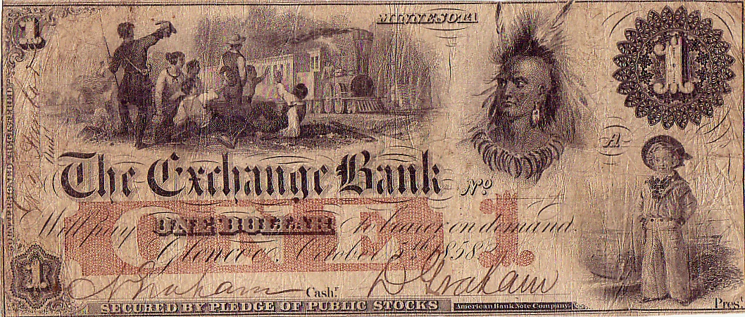
Exchange Bank of Glencoe A Railroad Bank
Notes:
A railroad note. Bank was organized by Graham brothers, railroad contractors.

Slide 65
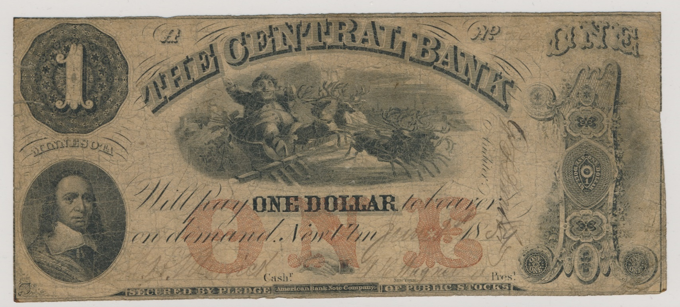
Central Bank of New Ulm An Investors Bank
Notes:
Central Bank organized by investors; they paid Merrick and Wagner to run the bank.

Slide 66
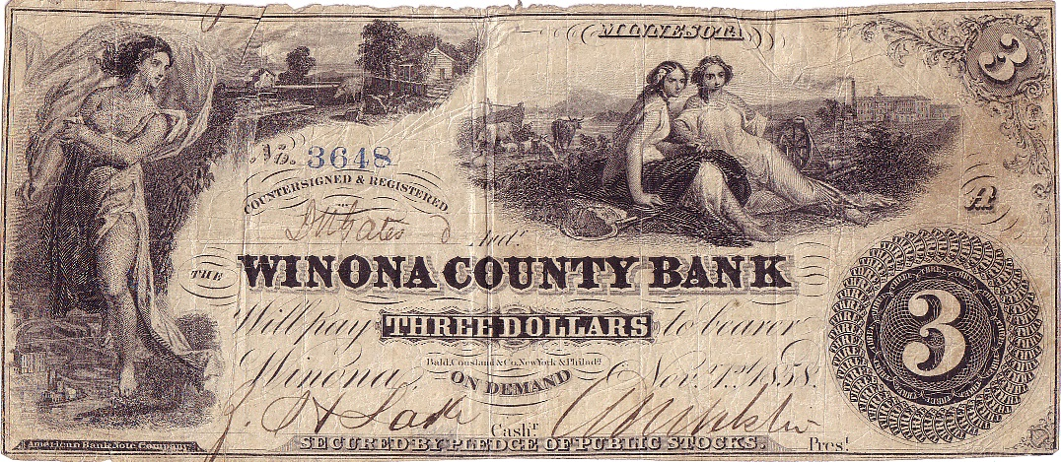
Winona County Bank A Bankers Bank
Notes:
In it for the long haul. Zaphna Lake and A. W. Webster.

Slide 67
Minnesota’s Free Banking
By May 1859
Valuation of railroad bonds became obvious
Bank note reporters were quick to adjust note valuations
All banks’ notes were considered unsafe
State auditor improved the required backing
New valuation at 60%
Shore up or close
Notes:
Could deposit more bonds or reduce circulation.
Eleven banks were in the process of closing by Summer 1859.
Nine of those failed = paid less than par.

Slide 68
Central Bank of New Ulm Returned Circulation to Auditor
Notes:
Knox brothers, bankers from St. Paul, bought the bank. They turned in bank notes on hand to shore up their deficiency.

Slide 69
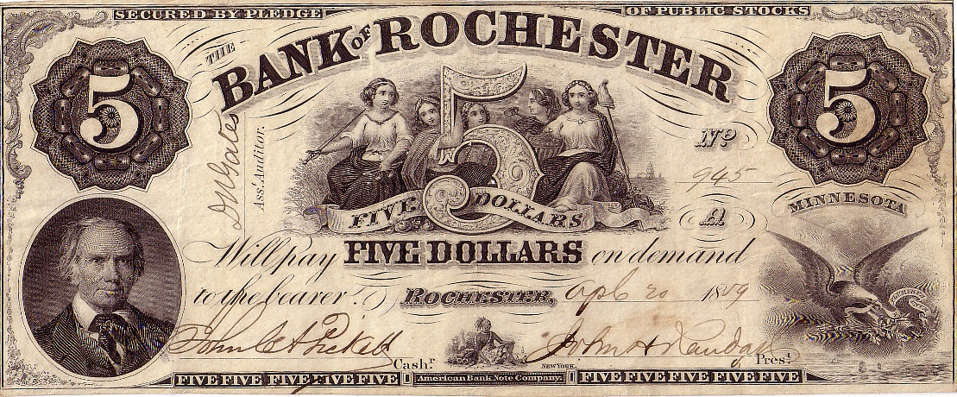
Bank of Rochester Chose to Close – Failed
Notes:
Many gave up all together. Notes redeemed at 16 cents on the dollar.

Slide 70
Minnesota’s Free Banking
By 1860
Market value of railroad bonds declined further
Minnesota free banking came to a deadlock
Civil War impacted all states
1861 – the war would not be short
Ohio 6s crashed
Wisconsin ran into trouble
1862 – the North lost recent battles
Hoarding of coin led to scrip issues
Notes:
Only four banks continued to operate through 1862:
Bank of Chatfield
Peoples Bank of St. Peter
Winona County Bank
La Crosse & La Crescent Bank of Hokah

Slide 71
Minnesota’s Bank Failures 1859-62
Exchange Bank, Glencoe… 21.25%
Bank of the State of Minnesota, St. Paul… 70.00%
Chisago County Bank, Taylors Falls… 19.25%
Bank of Owatonna… 20.75%
Bank of Rochester… 16.25%
Fillmore County Bank, Preston… 20.00%
Nicollet County Bank, St. Peter… 35.00%
Bank of St. Paul… 98.00%
Central Bank, New Ulm… 30.00%

Slide 72
Central Bank of New Ulm Knox Brothers cut their losses and closed

Slide 73
Minnesota’s Bank Closures 1859-62
State Bank of Minnesota (Austin)… 100.00%
Farmers Bank (Garden City)… 100.00%
Bank of Red Wing… 100.00%

Slide 74
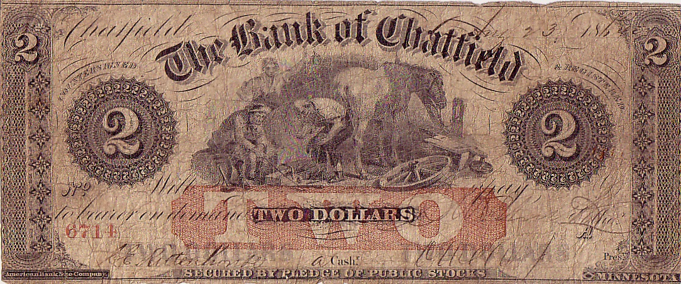
Bank of Chatfield Survivor
Notes:
One of the banks that endured.

Slide 75
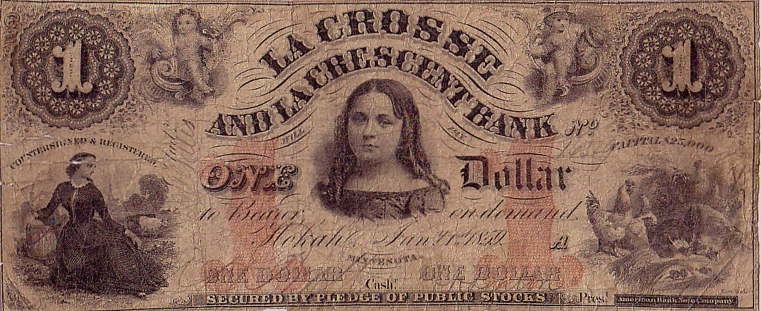
La Crosse & La Crescent Bank Survivor
Notes:
One of the banks that endured.

Slide 76
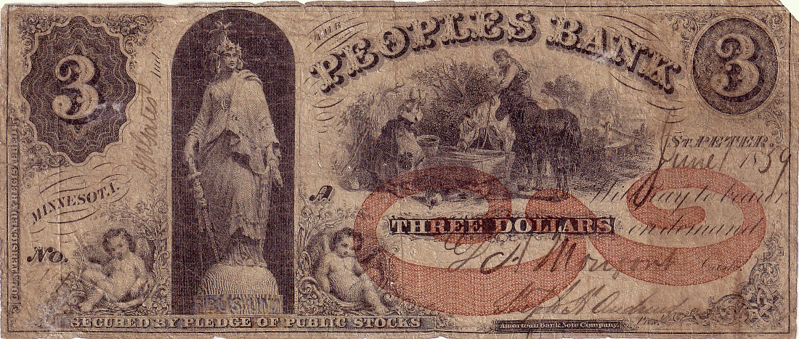
Peoples Bank Survivor
Notes:
One of the banks that endured.

Slide 77
Winona County Bank Survivor
Notes:
One of the banks that endured.

Slide 78
Minnesota’s Free Banking
Reboot in 1863
U.S. bonds required for note security
Solid footing
Par redemption among Minnesota banks
Tax of 1865
Many Minnesota banks converted to national status
Notes:
Minnesota gathered the political will to restart.

Slide 79
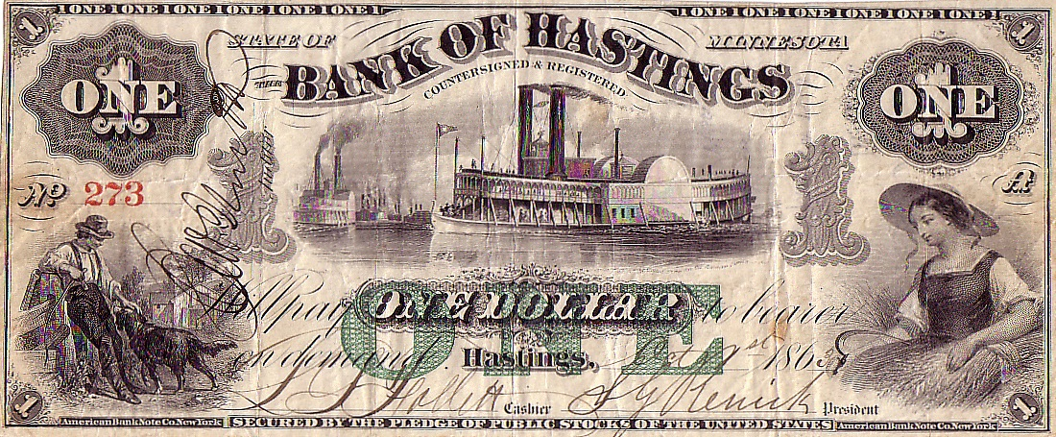
Bank of Hastings

Slide 80
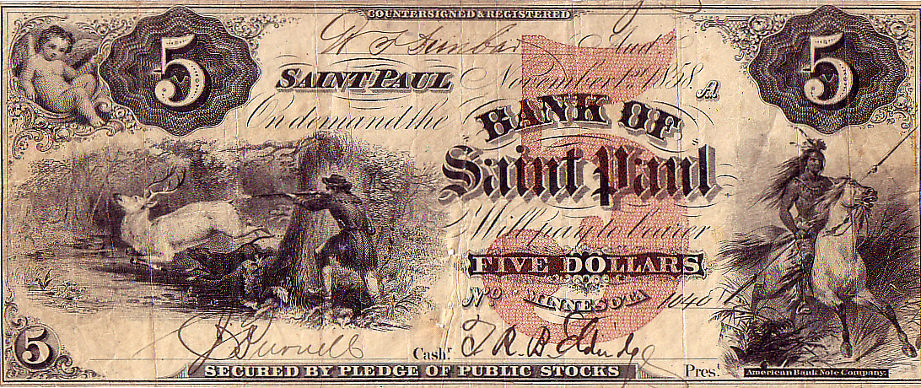
Bank of Saint Paul
Notes:
The plates used to make notes from this failed bank…

Slide 81
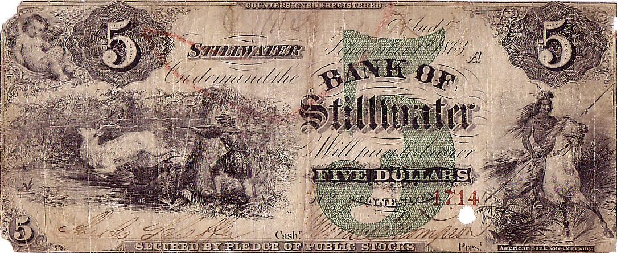
Bank of Stillwater
Notes:
Were re-engraved and put back to work.

Slide 82
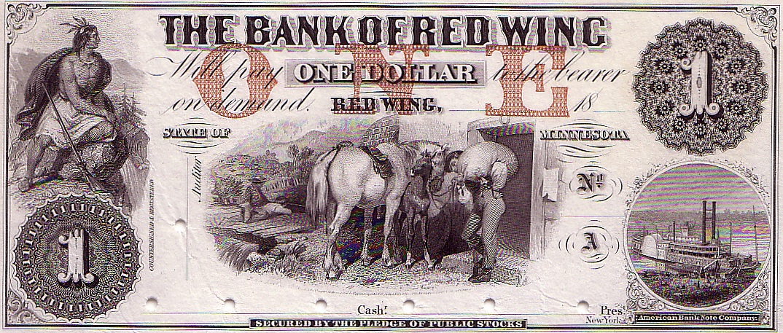
Bank of Red Wing (1st)
Notes:
The first Bank of Red Wing closed but did not fail.

Slide 83
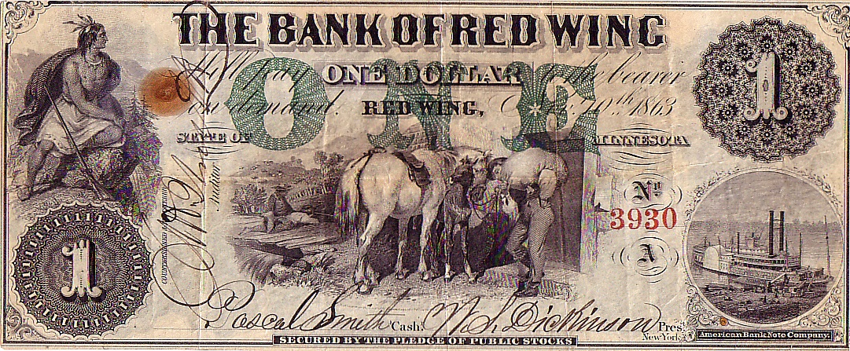
Bank of Red Wing (2nd)
Notes:
Brought back to life with new owners who recycled the plates.

Slide 84
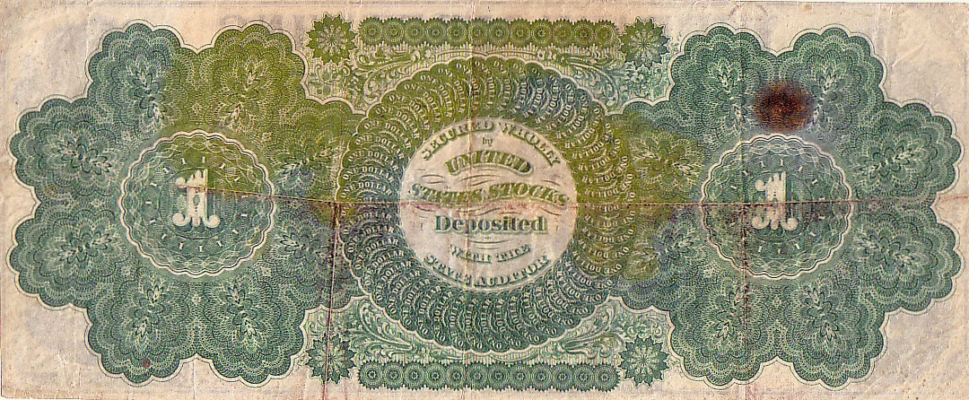
Bank of Red Wing (2nd)
Notes:
Added a printed back to make it known that these notes were backed by U.S. stocks.

Slide 85
Minnesota’s Bank Conversions
Bank of Hastings -> First NB of Hastings
Thorne’s Bank -> Merchants NB of Hastings
Minneapolis Bank -> First NB of Minneapolis
State Bank of Minnesota -> State NB of Minneapolis
Bank of Red Wing -> First NB of Red Wing
Marine Bank -> N Marine B of St. Paul
Bank of Minnesota -> First NB of St. Paul
Peoples Bank -> Second NB of St. Paul
Farmers Bank -> First NB of Shakopee
Bank of Southern Minnesota -> First NB of Winona
Winona County Bank -> United NB of Winona

Slide 86
Minnesota’s Free Bank Summary
26 banks issued
At least one issued note from each reported
Marine Bank was the last to surface (last year!)
9 non-issuing banks known to have notes prepared
4 proofs and remainders
2 proofs only
2 remainders only
1 unreported (Goodhue County Bank)

Slide 87
Collecting Minnesota
Are you up for the challenge?

Slide 88
Collecting Minnesota
A very difficult state
Short time of issue
Late to statehood
Few common notes
Most common are those of failed banks
Notes of par banks equivalent of national bank notes
Avid collector base
High prices
Deep South states most common
New England also common
“Western” states generally more difficult

Slide 89
Collecting Minnesota
Some of my favorites
Bank Notes
Scrip
Ancillary areas

Slide 90
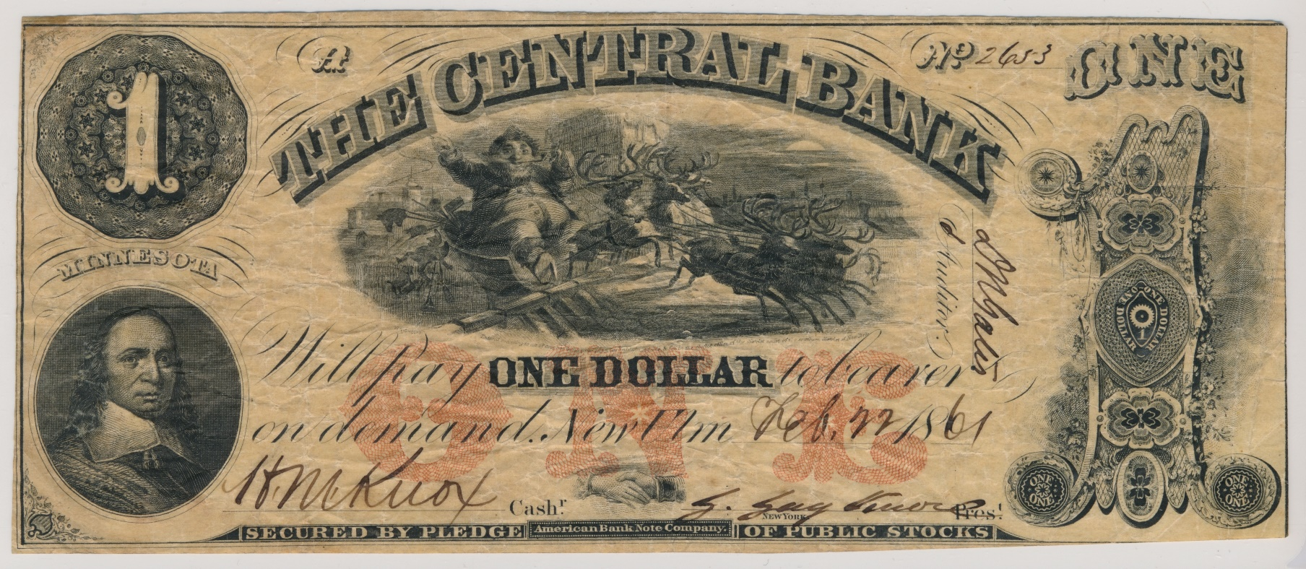
Discoveries Keep it Fun Central Bank

Slide 91
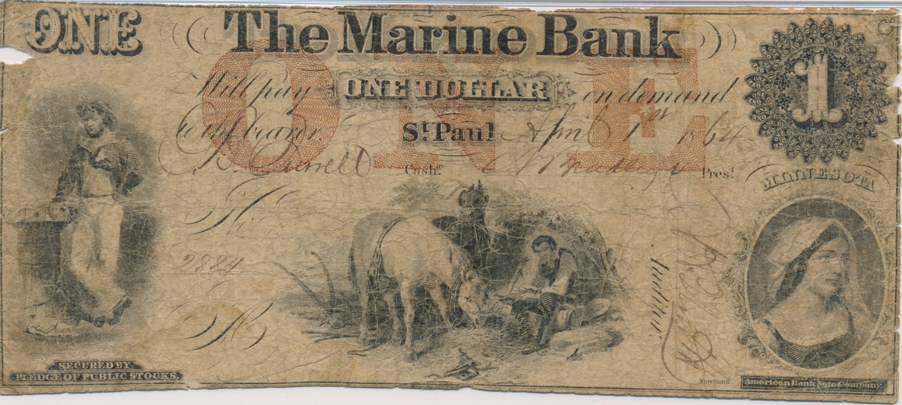
Discoveries Keep it Fun Marine Bank
Notes:
This completes my set of a note from each of the 26 issuing banks.
Another nine banks had notes printed but did not circulate. I have examples from eight of those.
Goodhue County Bank – none are reported.

Slide 92
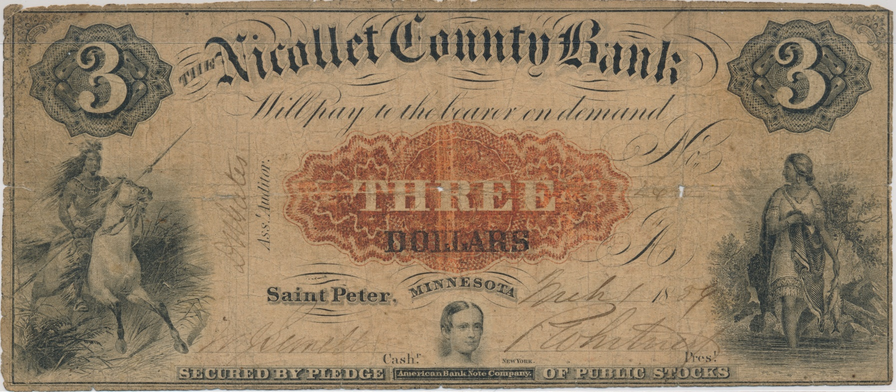
Discoveries Keep it Fun $3 Nicollet County Bank
Notes:
Had the $1, $2, and $5 for a long time. On my want list for 20 years.

Slide 93
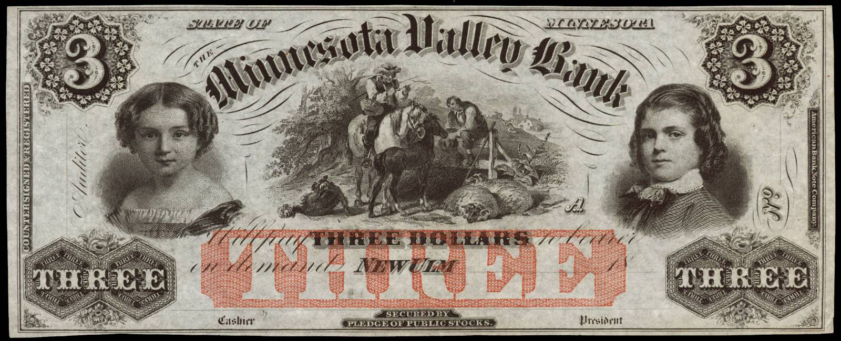
Discoveries Keep it Fun Minnesota Valley Bank

Slide 94
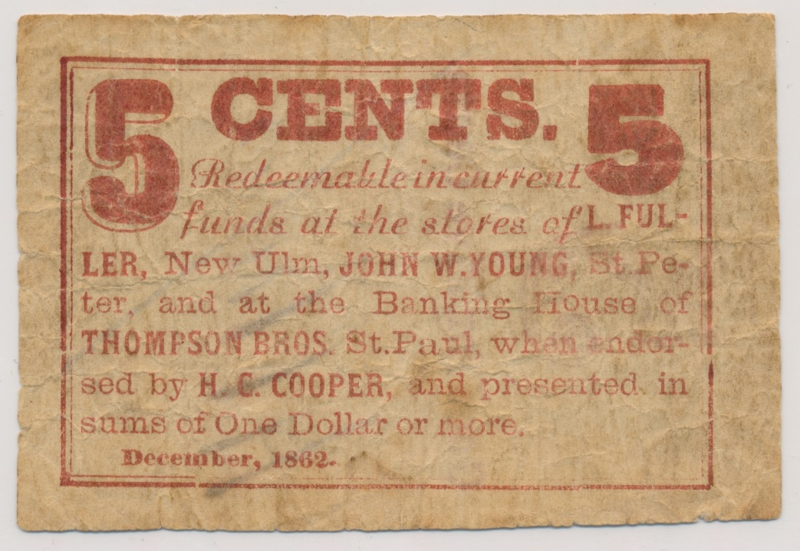
Discoveries Keep it Fun New Ulm /St. Peter Scrip

Slide 95
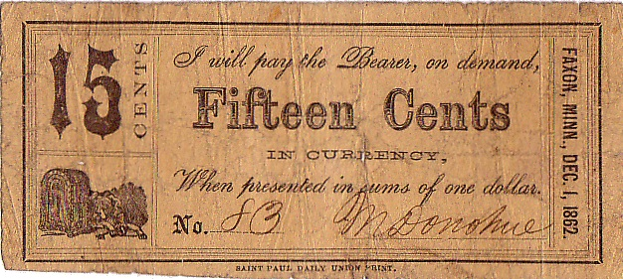
Scrip Not beautiful but rare!

Slide 96
Collecting Minnesota
Ancillary Obsoletes
Advertising Notes
College Currency
Panic of 1893
Panic of 1907
Depression Scrip
Labor Exchange Scrip
Cardboard Scrip
Tiffany Commission Scrip
U.S. Postal Notes
Savings Scrip

Slide 97
Collecting Minnesota
Where to start
Buy the book
Caveat emptor
Learn to grade
Research
Easiest to obtain
Dayton bank
Peoples Bank
Scrip

Slide 98
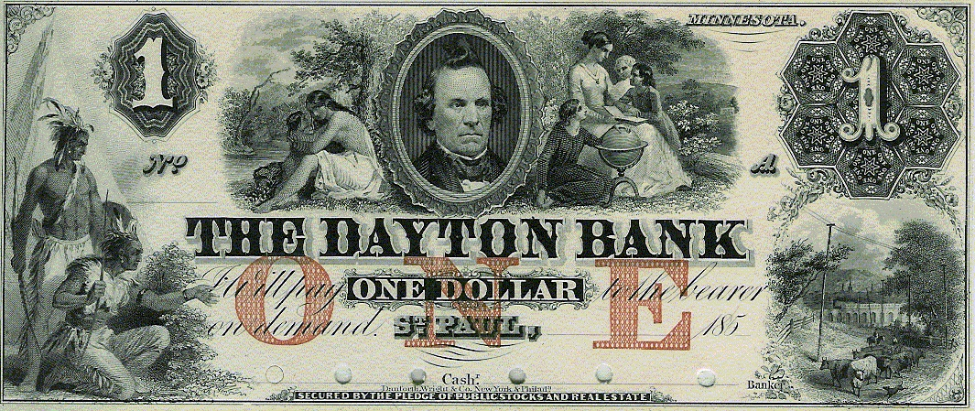
Easy Start Dayton Bank

Slide 99
Easy Start Peoples Bank

Slide 100
Easy Start R. J. Mendenhall

Slide 101
Easy Start C. H. Pettit Endorsed Note

Slide 102
Easy Start State of Minnesota

Slide 103
Collecting Minnesota
Where to find
Shows
Auction
Fellow collectors
Build a network
Join clubs
Travel to major shows

Slide 104
The End
Questions?

