Slide 1
Large Size Replacement National Bank Notes, 1903-1920
R. Shawn Hewitt
Memphis Speakers Series
2013 Memphis
International Paper Money Show

Slide 2
Large Size Replacement Nationals
Background
How to Identify Them
Statistics

Slide 3
Background
History and Discovery

Slide 4
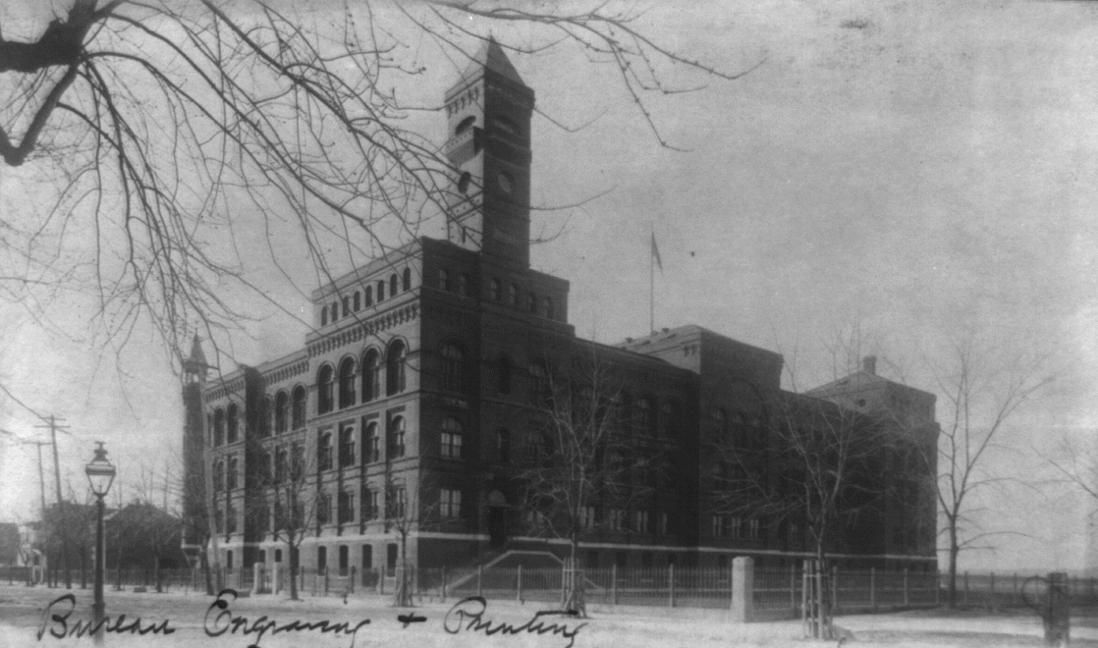
BEP: Printer of Perfection
Late 1800s at the Bureau of Engraving and Printing
Notes:
Set the stage. Late 1800s. The BEP has taken over currency production that was previously in the hands of private printers, and the demands on the Bureau have grown tremendously. A new facility was build for the Bureau, and this is what is it looked like in 1889. The expectation is not only that they produce bank notes and financial instruments for the country’s needs in a timely manner, but also that their products must be perfect. And, as we all know, when you introduce the human element, mistakes can and will happen…

Slide 5
BEP: Printer of Perfection
Sometimes sheets were imperfectly printed or damaged
It was important to preserve the integrity of the serial number sequences
Must make a perfect replacement, with serial numbers identical to the defective sheet
Notes:
Sometimes sheets of bank notes were imperfectly printed or damaged. Imperfect notes had to be removed. Its was NOT OK to leave a gap in the sequence of notes; nor was it OK to replace the gap with a randomly numbered note; at this time star notes were not yet conceived.
It WAS important to preserve the integrity of serial number sequences. Therefore, whenever a printing mistake was made, a perfect replacement had to made, meaning that the serials had to be identical to the defective sheet.

Slide 6
Numbering Technology at BEP
Foot activated numbering machines
Single action - impressed one number at a time
Designed and made in-house
Patented in 1874 by BEP employee James D. Smith
Notes:
Let me take you on a tour of the Numbering Division of the BEP.
You’ll see several rows of large numbering machines, all of which are operated by women. The numbering machines were foot activated with a treadle, much like a sewing machine. And they were single action – meaning only one number was impressed at a time.
These numbering machines were the brainchild of BEP employee James D. Smith – an industrious man who made several inventions related to numbering, and some for other applications at the Bureau. His earliest patent was for a paging machine in 1870. By 1874 he made it into a tabletop workstation. This is what it looked like on paper…

Slide 7
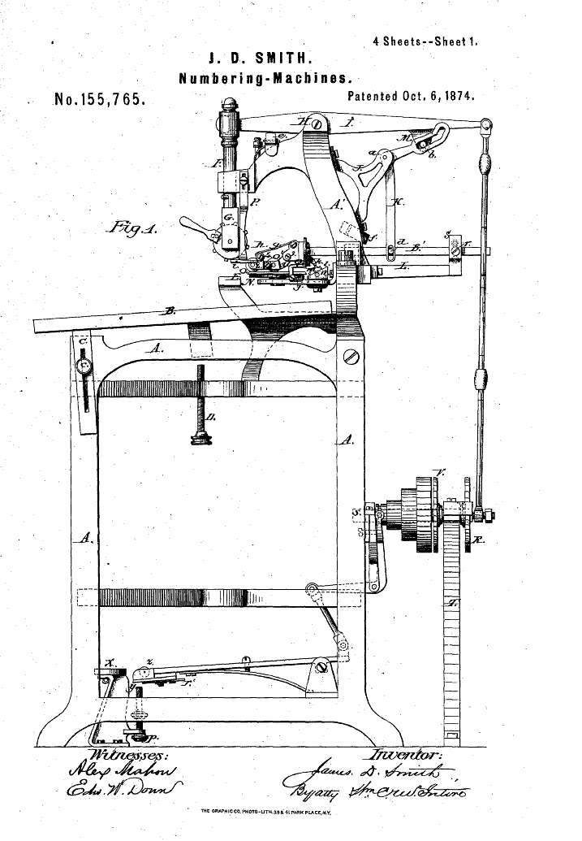
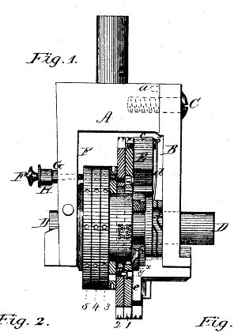
Notes:
This is a diagram that was filed with the patent application for this device. Other parts of this device were separately patented. The foot treadle on the bottom was separately patented. The braking mechanism was another.
To number a sheet of type notes, the operator needed to place the sheet in the exact location relative to the numbering head starting at the top, depress the foot treadle to make an impression, repeat for the second number on the note, and then pull the lever to advance the number for the next note. The process was then repeated for the remaining three notes on the sheet.

Slide 8
Numbering Technology in 1890
Notes:
Here it is in practice. A lady operator is numbering Silver Dollar Backs. The same presses were used for type notes and national bank notes.

Slide 9
Single Action Machine
Notes:
Here is a closer look. The sheet is bent over the platen. Precision was very important, just like sewing with a treadle sewing machine.

Slide 10
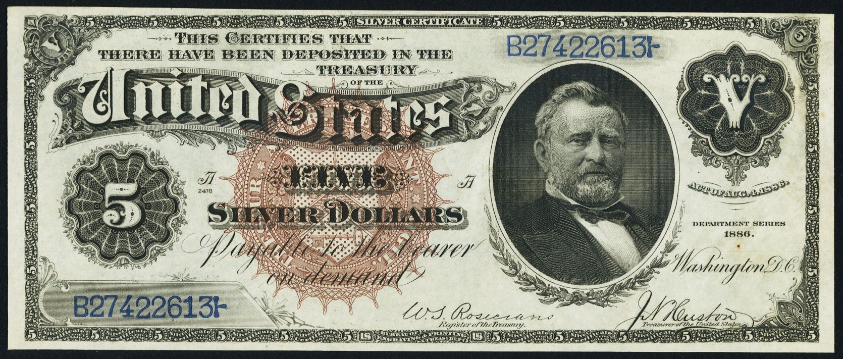
The Finished Product
Notes:
Here is the finished product. Take a look at the serial numbers – the fonts in particular. They have a certain style to them.

Slide 11
Numbering Nationals
Same treasury number on each sheet
Operator stamped four times in precise locations, advanced the number, continued with next sheet
Later, repeat for bank serials
Notes:
Numbering nationals was a little different than numbering type notes. The same treasury number was applied to each sheet. The operator stamped it four times in precise locations, advanced the number, and continued with the next sheet. Later, the same process was repeated for bank serials.
That sums up the numbering technology in the late 1880s.

Slide 12
Sometime after 1900, the serial number fonts changed
Droopy 2
Hunchback 3
Long-handled 4
Closed fonts
Notes:
Now, let me shift gears.
As a collector, you spend time looking at a lot of notes, and recognize some patterns along the way. Something I noticed a while ago is that some Red Seals have different kinds of fonts.
The top row is what I call old style fonts. Note the distinctive look to them.

Slide 13
When did the changeover occur?
NBNCensus.com
Discovered that a changeover in fonts occurred:
Around B240,000 for $10 and $20 Red Seals
Around A530,000 for $5 Red Seals
Recall that you can date a note by its treasury number
Checked Table 9 in Huntoon’s book:
Fall 1903
Notes:
About the time I was first asking these questions – February 2012 – Andrew Shiva had just opened up NBN Census online. I found that to be a pretty valuable and easy to use resource.

Slide 14
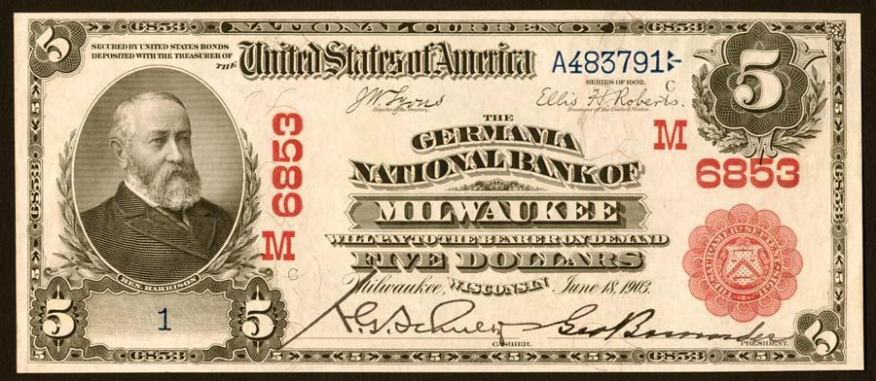
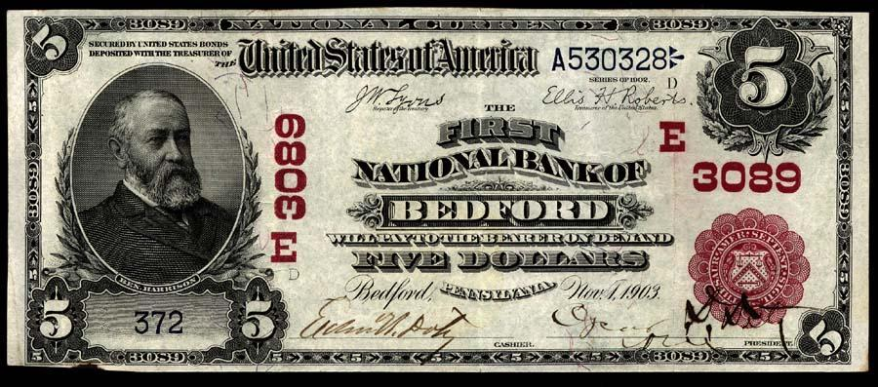

Slide 15
Why did the fonts change?
Indication of change in numbering technology
1903 BEP Annual Report describes capital improvements including new light and power plant; conversion to electrically powered equipment underway
A new, more sophisticated numbering machine was installed at the BEP
Notes:
The more important question is WHY did the fonts change…

Slide 16
New Numbering Machines
Notes:
From 1904 “The Making of Government Securities” by BEP Director William Meredith.

Slide 17
Another Innovation by James Smith
Notes:
From the 1908 Congressional Record. A survey of government employees that had filed patents.

Slide 18
Numbering Technology in 1908
Notes:
Here it is in practice. Lady operator feeding in sheets of $5 Series of 1902 nationals. Young man proofing the work seated next to her.

Slide 19
Notes:
Get a closer look. Sheets fed in top down. Rotate around cylinder to receive numbers from an outer cylinder.
Note that the charter numbers, geographical letters and treasury seal were not applied with this press. They were added at a later step in the production, using a flatbed press.

Slide 20
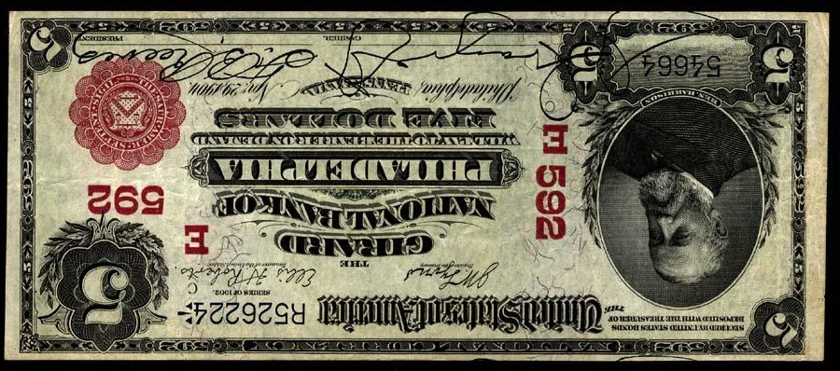
Plate Position C
Treasury Serial
Bank Serial
Plate Position D

Slide 21
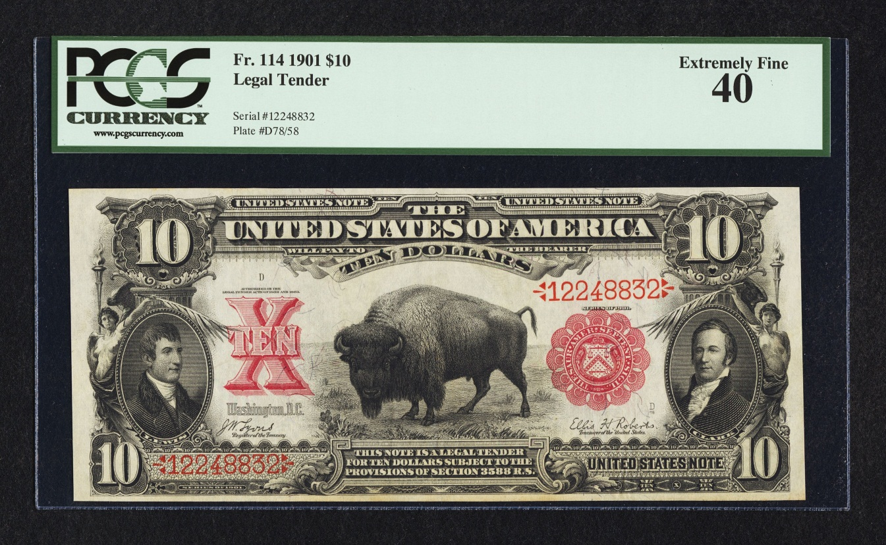
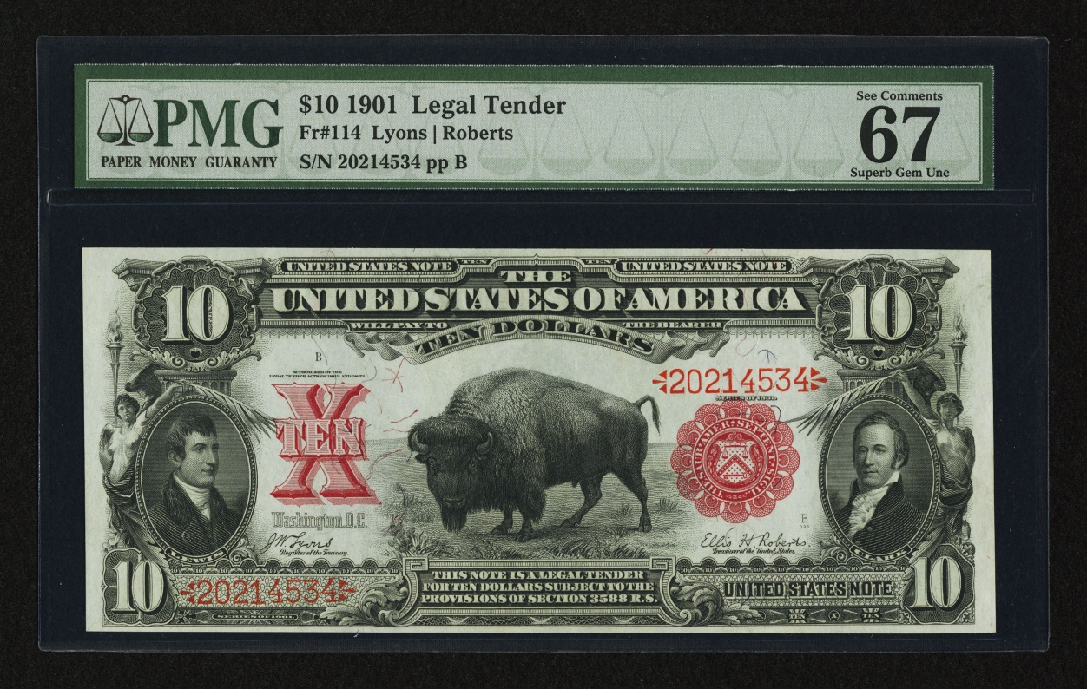
Type Notes, too!
Notes:
This applied to type notes as well. Note the top Bison has old style fonts and is numbered in the 12M range. Around s/n 20M a changeover is observed to new style fonts.

Slide 22
Evolution of Numbering Technology at BEP
Single action foot powered press
Rotary numbering machine
All notes numbered after conversion to the rotary presses have new style font…
Notes:
We might come to the conclusion that all notes numbered after the conversion to the rotary presses have the new style font.

Slide 23
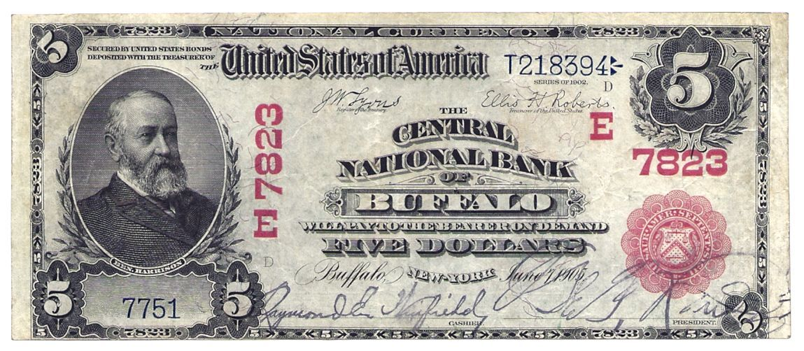
But Wait!
What about Red Seals with high charter numbers?
7000, 8000 and 9000 charter notes
Notes:
Like this one. Note the treasury number – old style fonts. Check out the charter number – and plate date – 1905. Why does this note have old fonts?

Slide 24
How common are these exceptions?
NBN Census
Heritage Archives
Ebay
Online Dealer Inventories
Viewed 2500 images of 1902 Red Seals

Slide 25
Out of 2500 Red Seals
Found 22 that were printed after 1903 but had old style fonts.

Slide 26
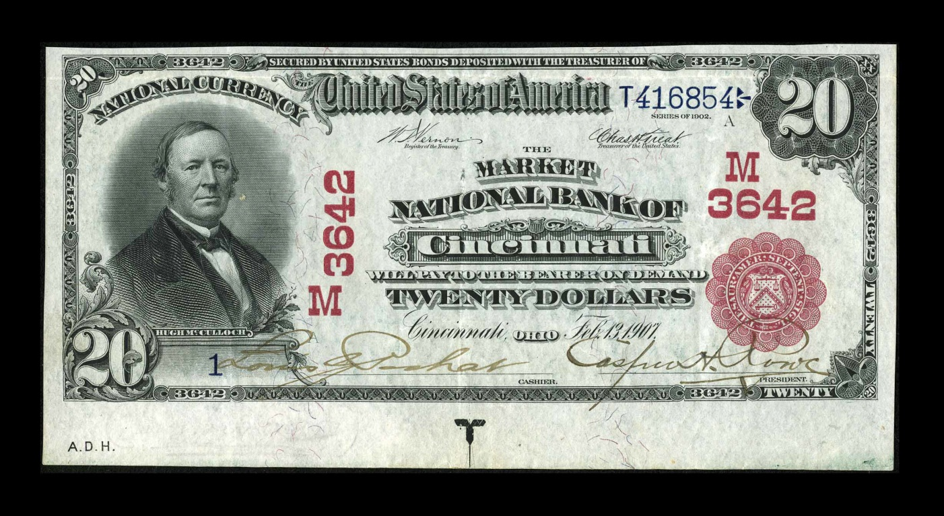
Out of 2500 Red Seals
Most were serial number 1 (twelve #1 notes)
Sounds familiar! (think 1929 replacements)

Slide 27
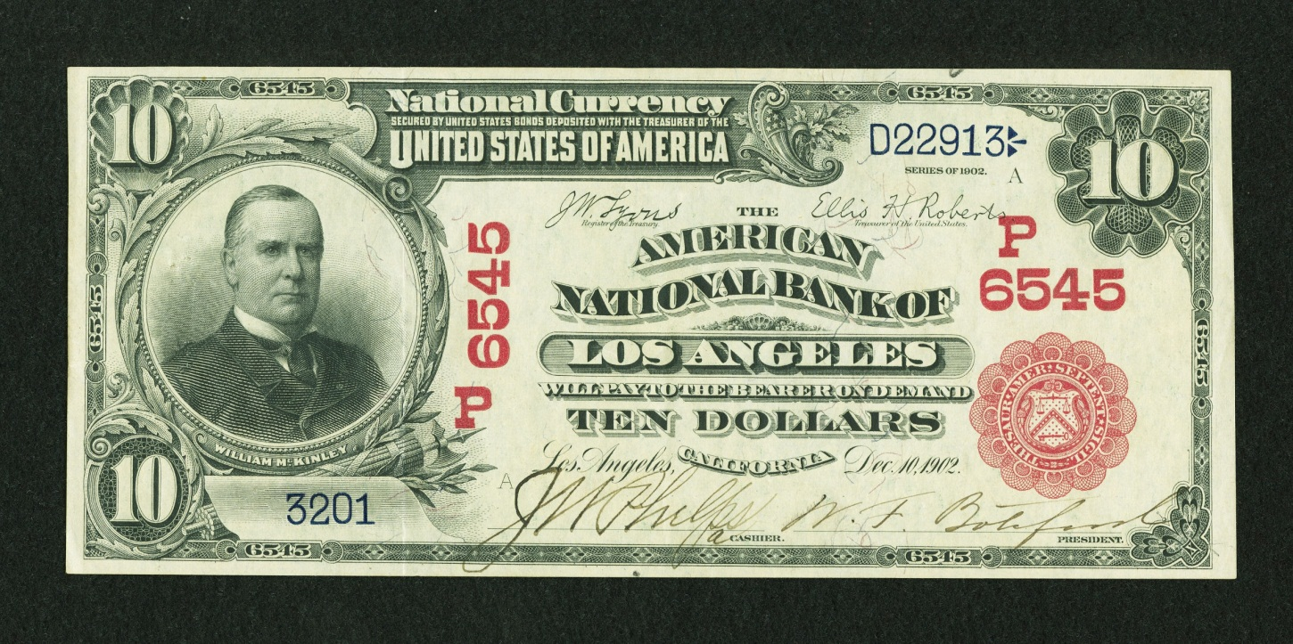
Out of 2500 Red Seals
Of the other serials, several looked as if they were the first-of-run note.
E.g. 301, 3201, 7751, 8501

Slide 28
Out of 2500 Red Seals
D22913 - D23512
3201 - 3800

Slide 29
Out of 2500 Red Seals
These notes were one-offs.
Printed in the same run with notes that had contemporary serial number fonts.
Recall treasury numbers and bank numbers track in tandem.
If the difference in both the treasury and bank serials of two notes are the same, they are from the same run.

Slide 30
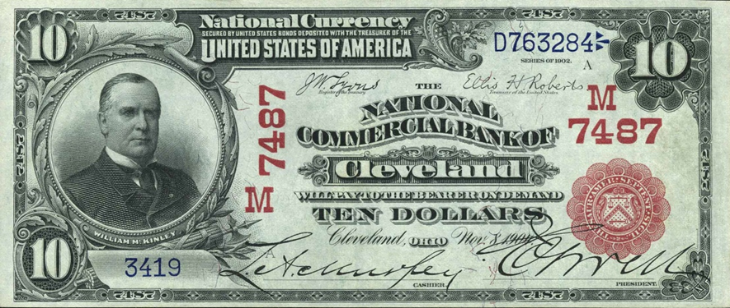
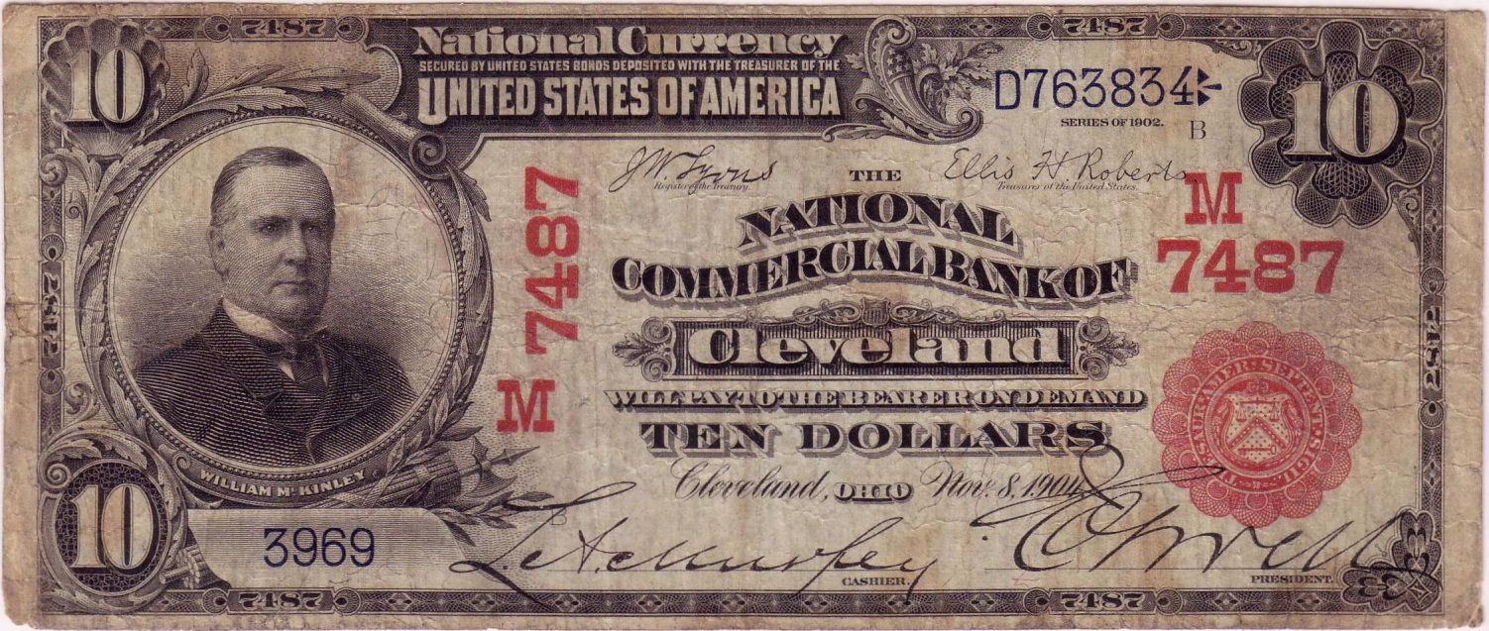
Out of 2500 Red Seals
Three old-font/new-font pairings found
Notes:
Difference of 550 in bank and treasury numbers. Same run.

Slide 31
Sometimes low tech solutions are best
Hypothesis: Old manual serial number presses were retained for the purpose of replacing defective sheets with perfect identically numbered sheets.
For a single replacement, it was easier to make a new sheet using the old press than to reset the numbering heads on the rotary press – and hold up production in the process.
That was the state of research as of one year ago, at Memphis 2012.
Now what?

Slide 32
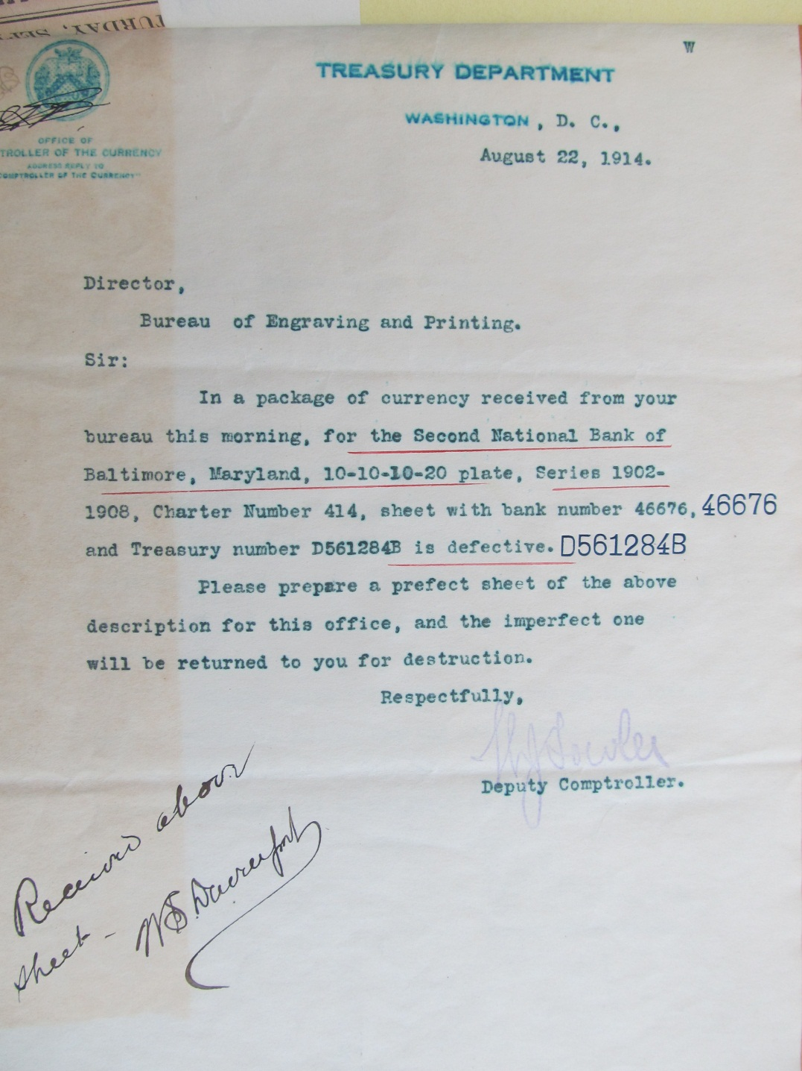
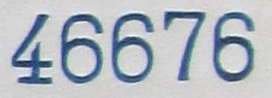
Notes:
Well, as a direct result of the their work on 1929 replacements, Huntoon and Simek produced this at Memphis 2012 last year, from the archives at the Smithsonian.
It is a letter from the OCC to the BEP asking for a make up sheet. I’ll read it…
What’s very interesting is that the numbering operator stamped test impressions on the letter.
Look at the fonts. They were made from the old single action press. This is the smoking gun I was looking for. **This letter ties old style fonts to replacements in the rotary press era.**

Slide 33
End of the Era
Found no replacements made after 1920
Change in policy
Huntoon observed ledger entries where defective notes were cancelled instead of being replaced
Change in technology

Slide 34
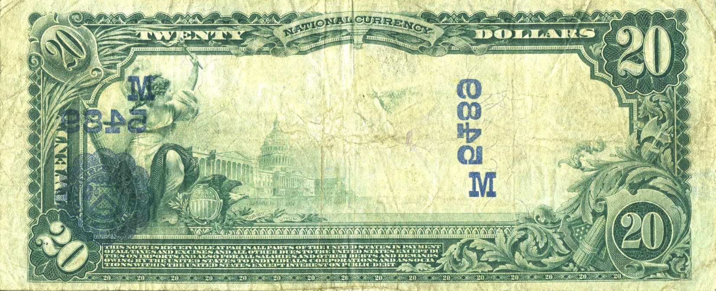
Tale of Two Errors
1920 offset transfer error
Notes:
This note was printed in 1920. We know that from the treasury serial number. Note that the offset transfer does NOT include the serial numbers. Just like the early Red Seals, they were applied before the charter number and treasury seal in a separate step.

Slide 35
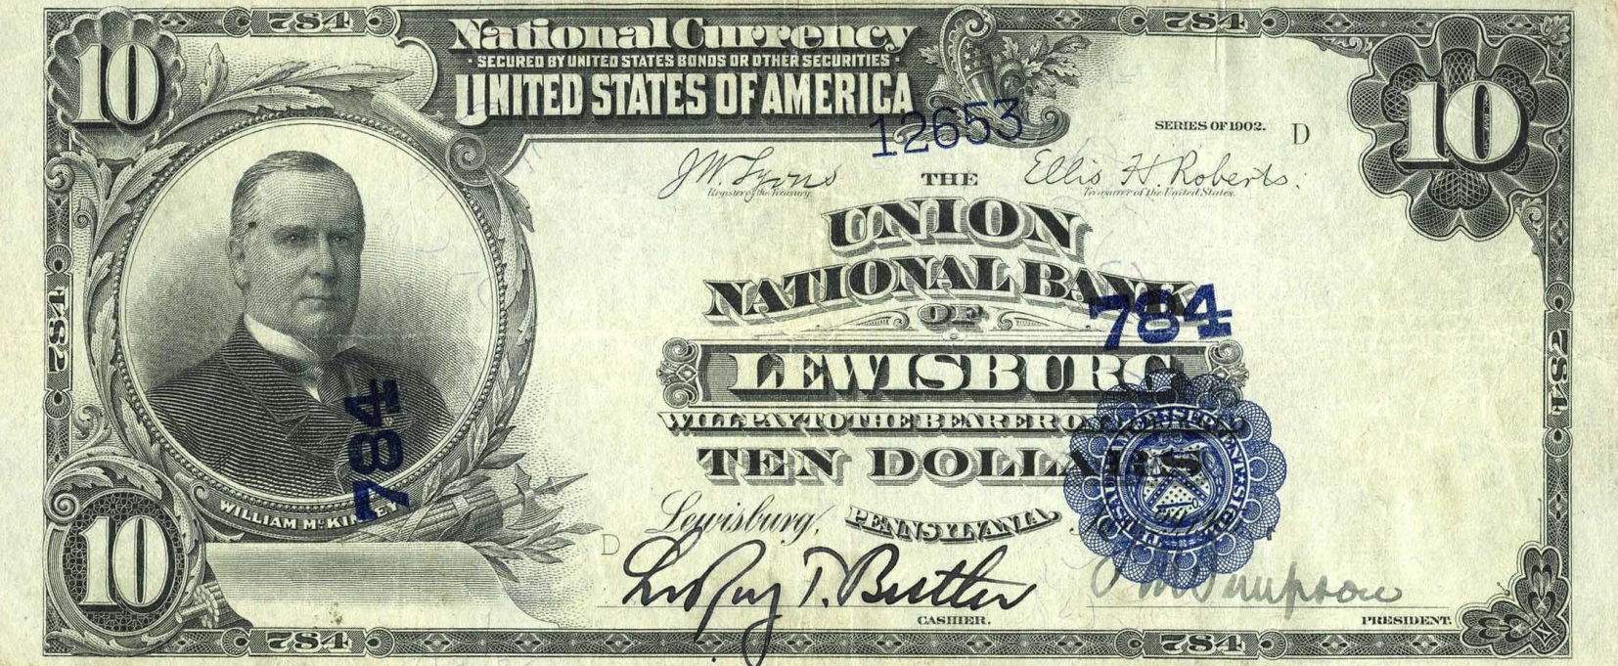
Tale of Two Errors
Ca. 1925 misalignment error
Notes:
This note was printed around 1925. On this note, the serial was applied at the same time as the charter numbers and treasury seal. This tells us that the technology changed. The serials were applied on a flatbed press, and the rotary numbering press was discontinued.
My guess is that in the name of productivity, the BEP abandoned replacement serials when the flatbed application of serials began.

Slide 36
How to Identify LSRNs
It’s easier than you think

Slide 37
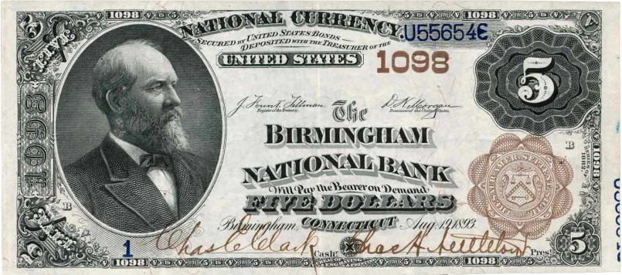
Identification
Remember that this research covers period after 1903
After BEP changed fonts to new style
We don’t yet know how to identify replacements made before this time

Slide 38
Identification
Old Style Fonts
Replacements
Printed after 1903

Slide 39
1882 Brown Backs
Most often misidentified
To properly identify, a note must be printed after 1903
Use this table:
Plate Layout | Serial Number
5-5-5-5 | H705403H
10-10-10-10 | all qualify
10-10-10-20 | E538996E
50-100 | B474307
Notes:
Start with the series that is most difficult to correctly identify. Most Brown Backs were printed using the old presses and therefore have old style fonts. Don’t be fooled!
To properly identify a note, it must have been printed after 1903. We use the treasury serial numbers to determine when nationals were printed. The serials in this table represent the approximate changeover to the new rotary presses in the fall of 1903.

Slide 40
Brown Back Treasury Serial Number Sequences
A-
B-
D-
…
Y-
Z-
A-A
B-B
D-D
…
U-U
V-V

Slide 41
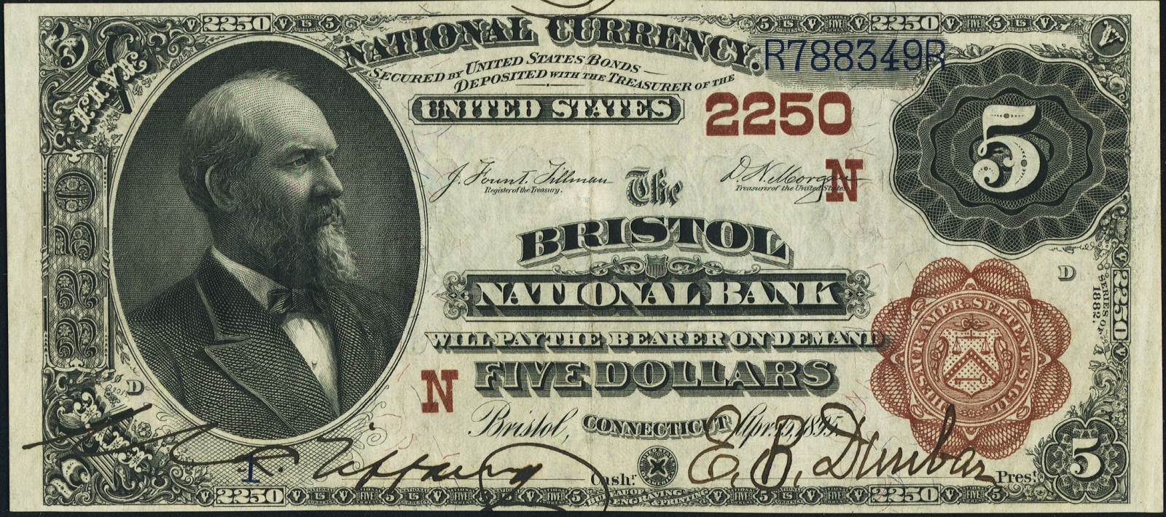
Use Geographical Letters to Filter
First applied in 1902
Discontinued in 1924

Slide 42
This is a test!
Try your hand at identifying replacements

Slide 43
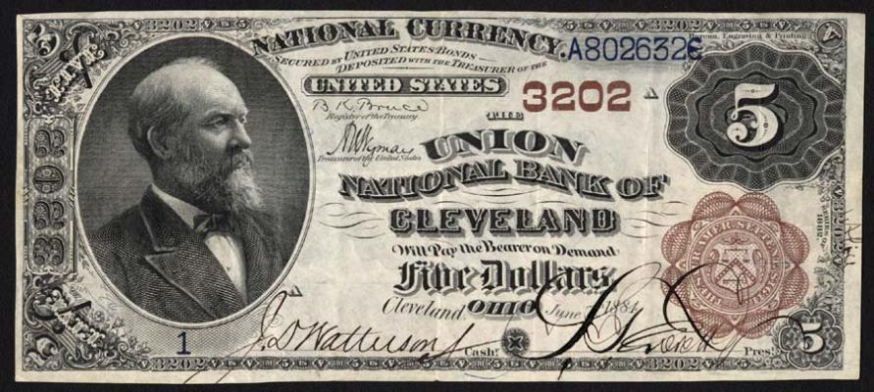
Is this a replacement?

Slide 44
No.
Printed before 1903
Notice no geographical letter

Slide 45
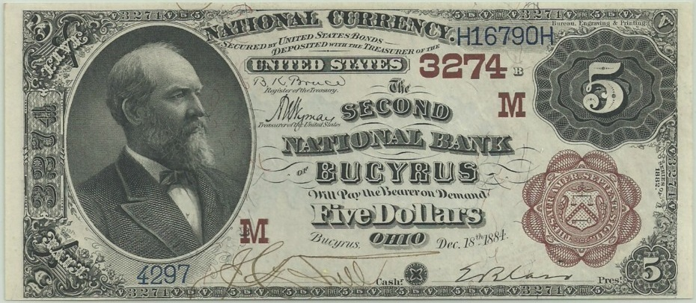
Is this a replacement?

Slide 46
No.
Has geographical letter, so printed after 1902
Treasury serial predates the changeover

Slide 47
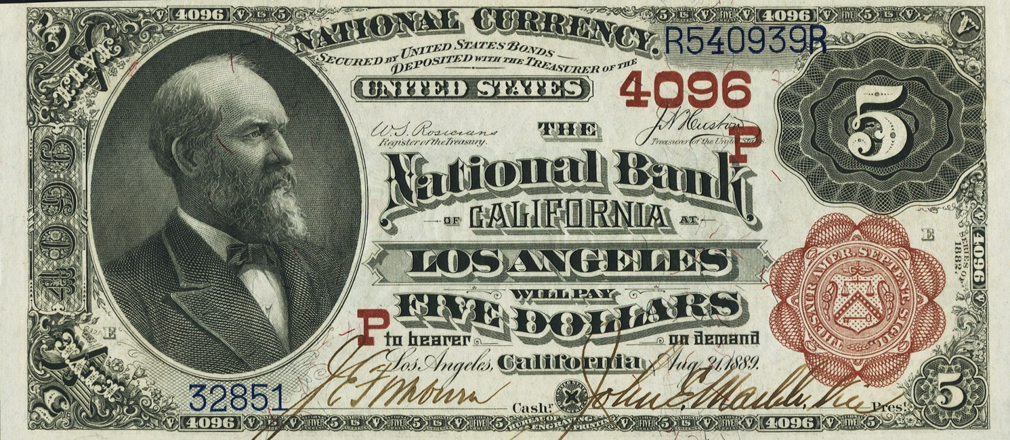
Is this a replacement?

Slide 48
No.
Has new style font

Slide 49
Is this a replacement?

Slide 50
Yes!
Printed after conversion to new style fonts.
Has old style fonts.

Slide 51
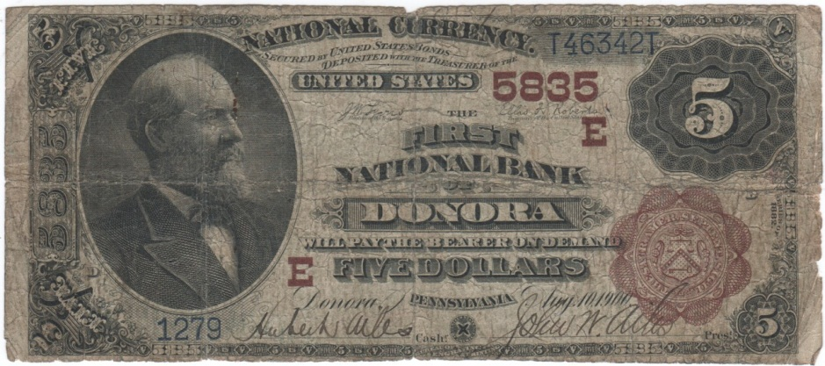
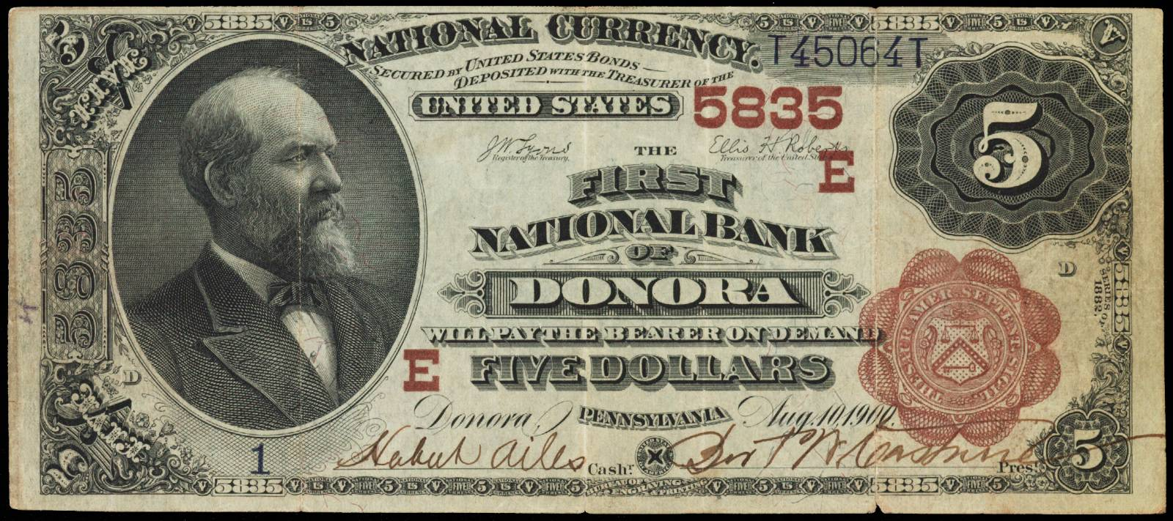
Matching Run and Plate Positions

Slide 52
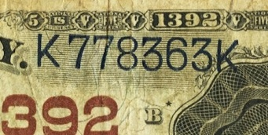
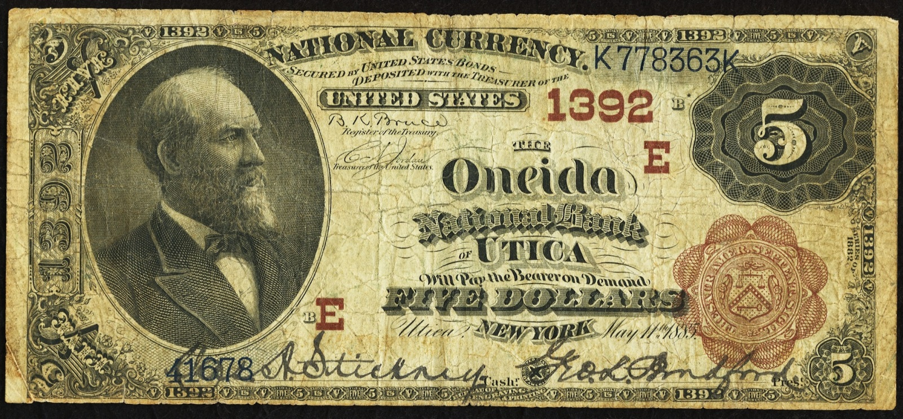
The Ultimate Replacement?
Notes:
Not only a replacement, but its on a re-engraved (star) plate.

Slide 53
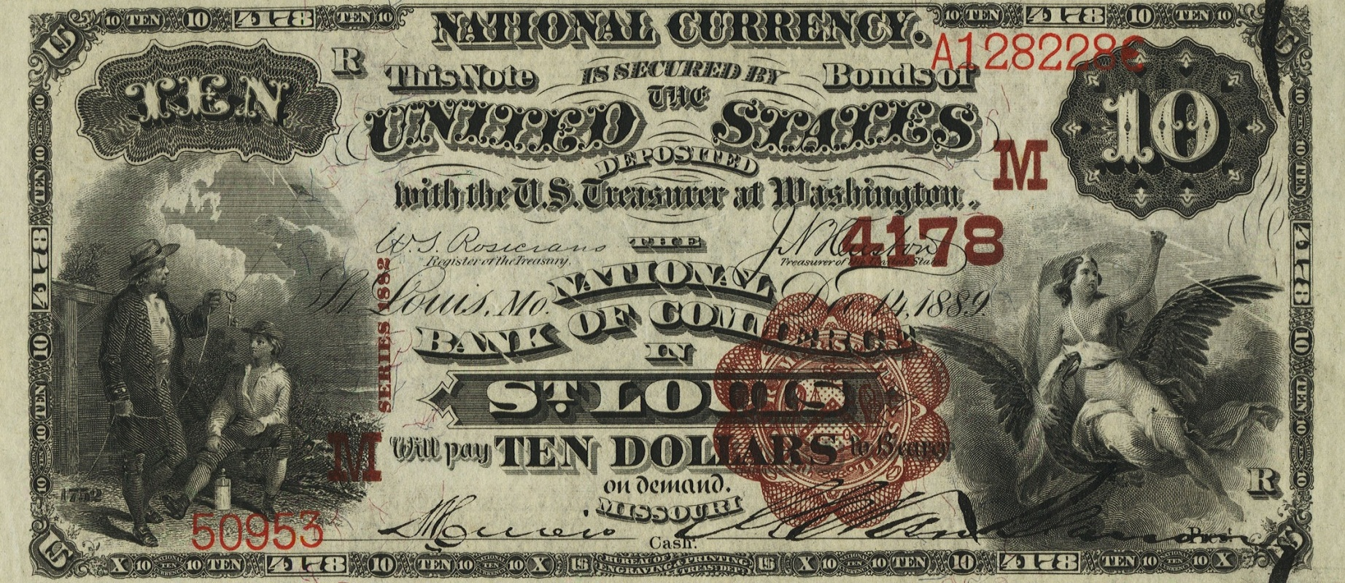
Is this a replacement?
Notes:
Seemingly paradoxical serial number. Being from the A- block, it looks like it should be from the 1880s? But, the note also has geographical letters, so it was made after 1902. What’s going on?

Slide 54
Yes!
Printed after conversion to new style fonts
Has old style fonts
Serial number is not out of range
Printed from a 10-10-10-10 plate
Introduced to Red Seals and Brown Backs in 1906
Notes:
Serials from 10-10-10-10 plates began with the A- block.

Slide 55
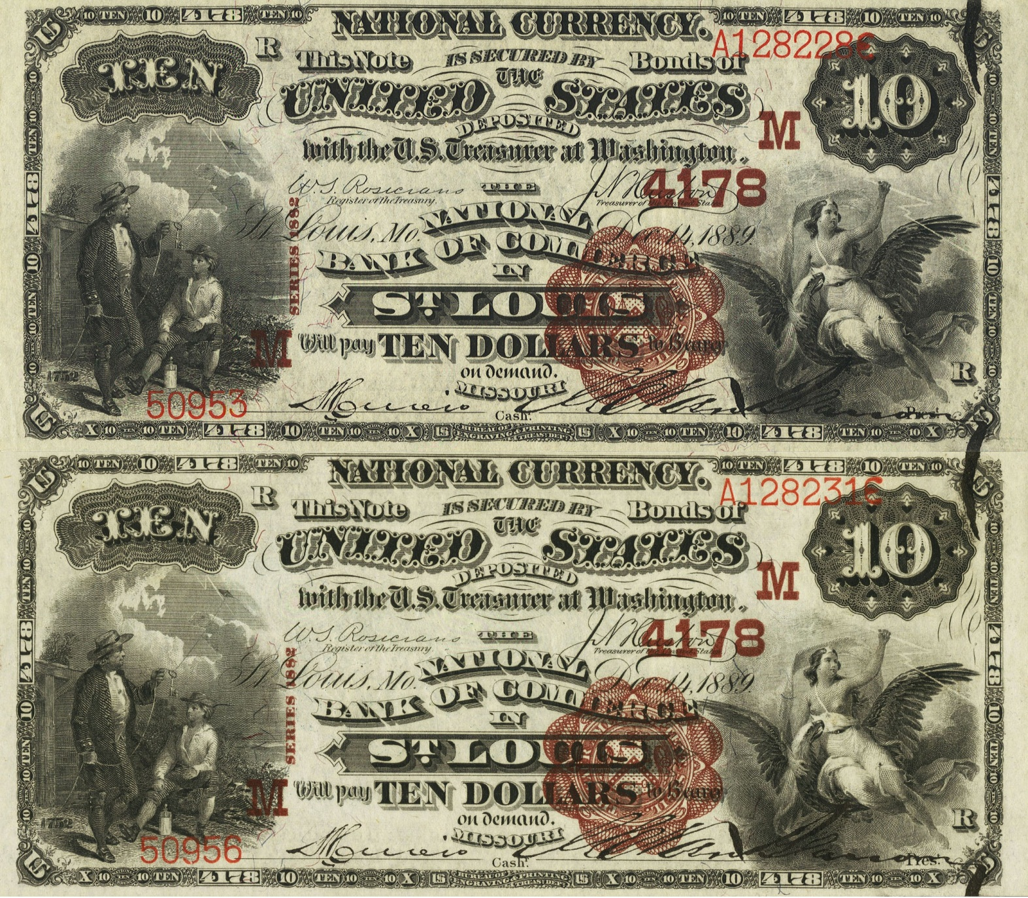
Notes:
Here it is compared to a closely numbered sister.

Slide 56
1902 Red Seals
Can be misidentified
To properly identify, a note must be printed after 1903
Use this table:
Plate Layout | Serial Number
5-5-5-5 | A530328
10-10-10-10 | all qualify
10-10-10-20 | B241777
50-100 | A92661
Notes:
The first 18 months of Red Seals were printed using old equipment.

Slide 57
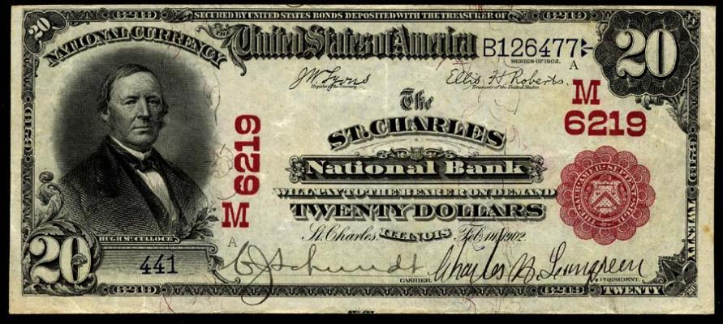
Is this a replacement?

Slide 58
No.
Treasury serial predates the changeover

Slide 59
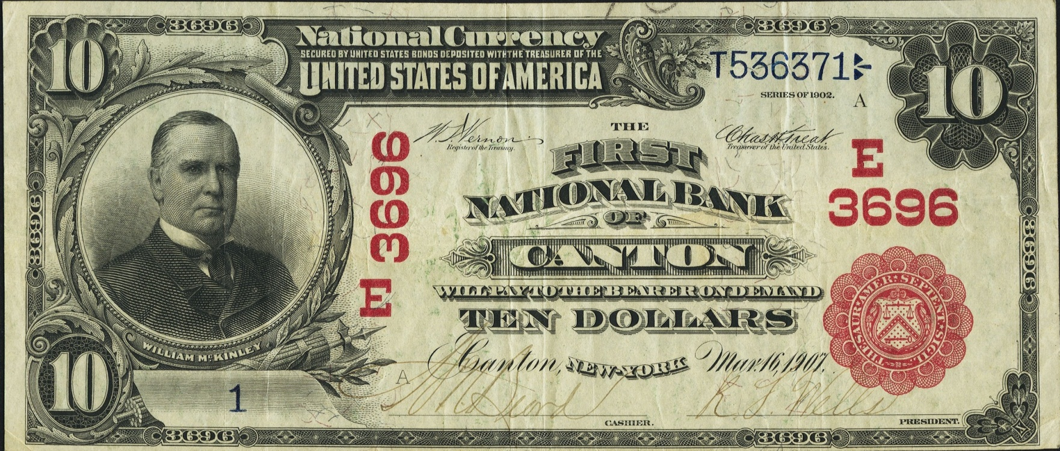
Is this a replacement?

Slide 60
Yes!
Printed after 1903.
Has old style fonts.

Slide 61
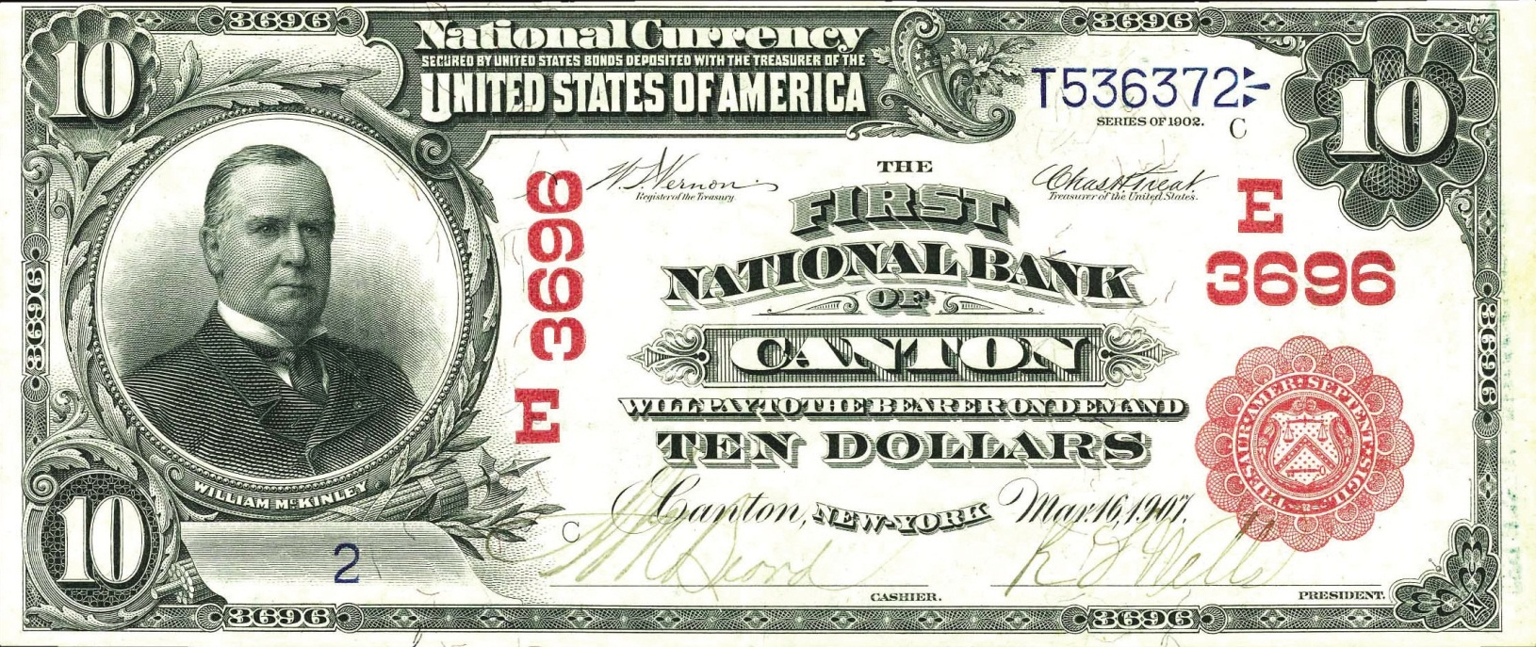

Slide 62
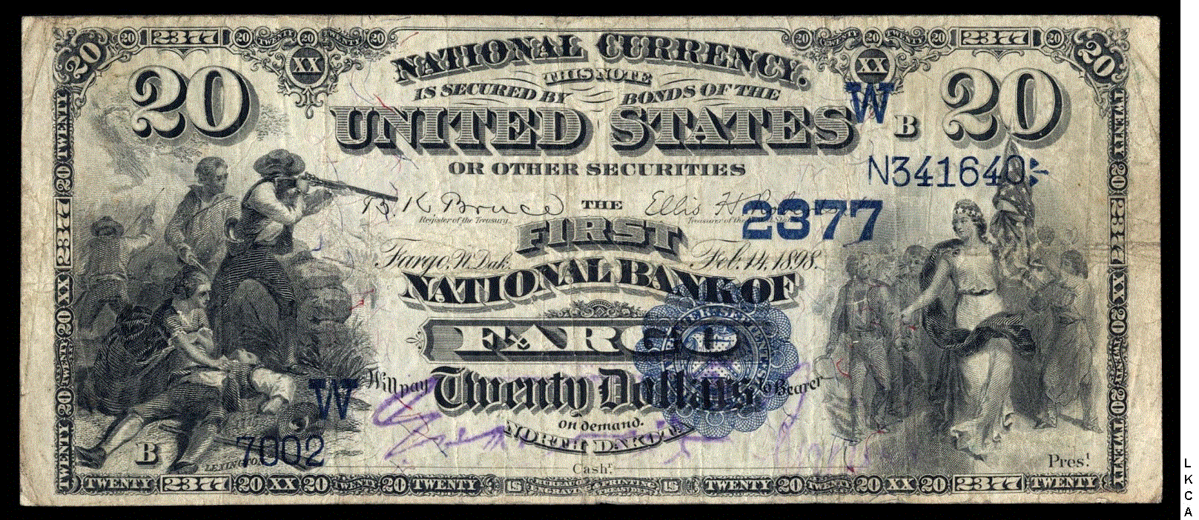
1882 Date Backs
Started in 1908 and ended in 1915
Therefore, no serial number conditions.

Slide 63
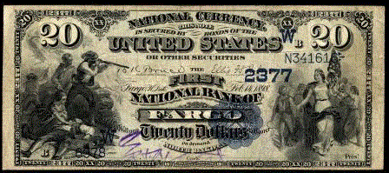

Slide 64
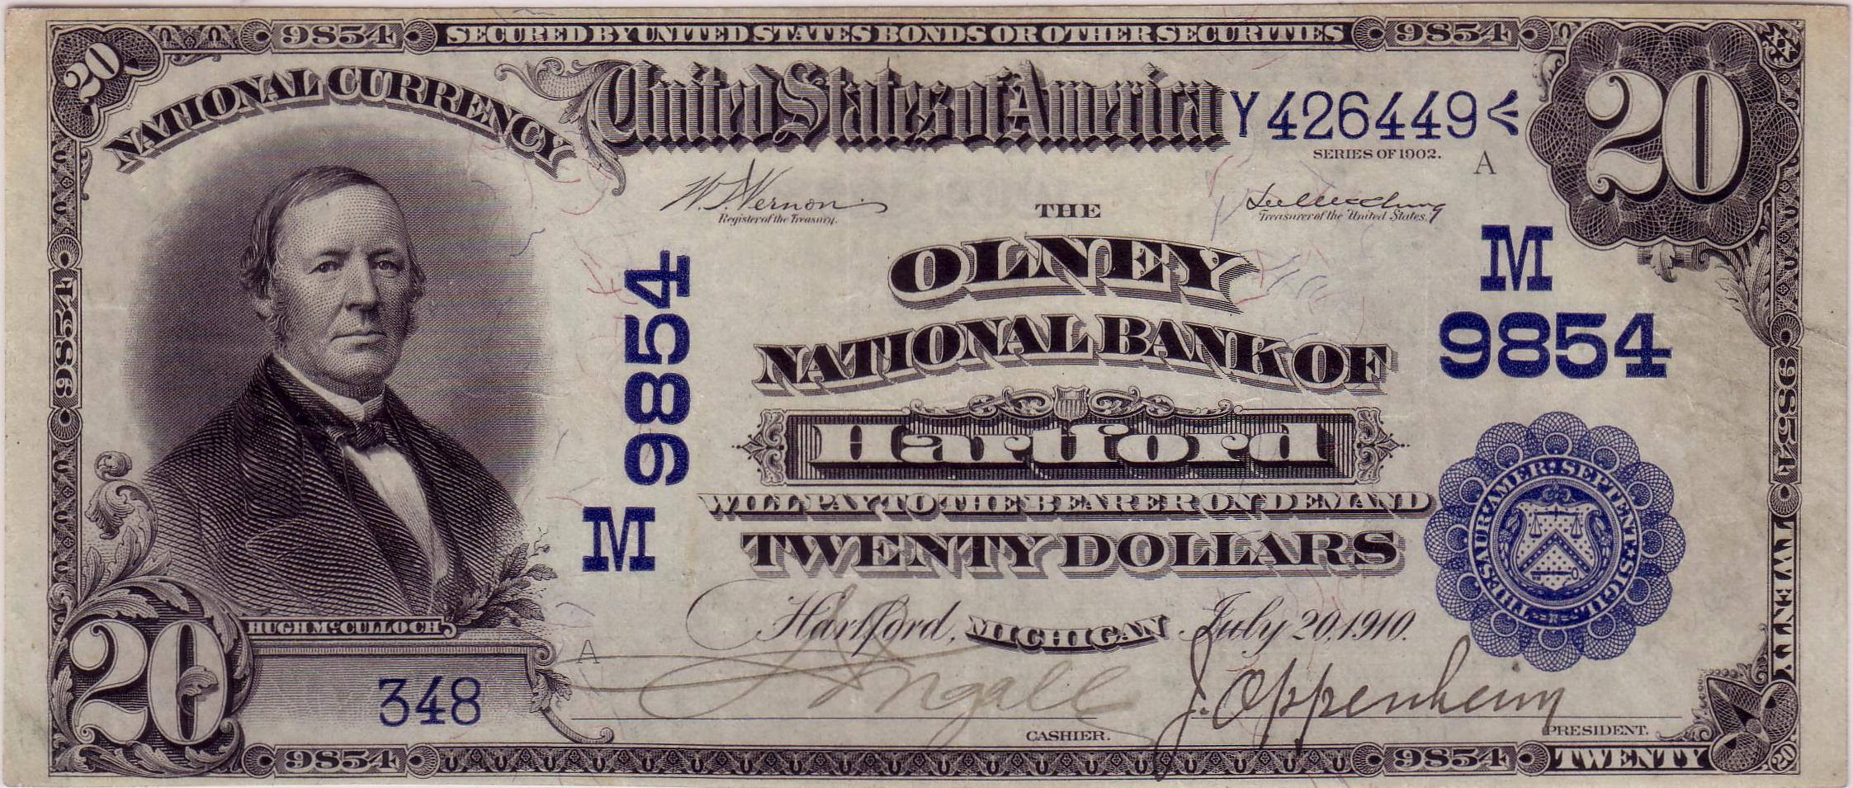
1902 Date Backs
Started in 1908 and ended in 1915
Therefore, no serial number conditions.

Slide 65
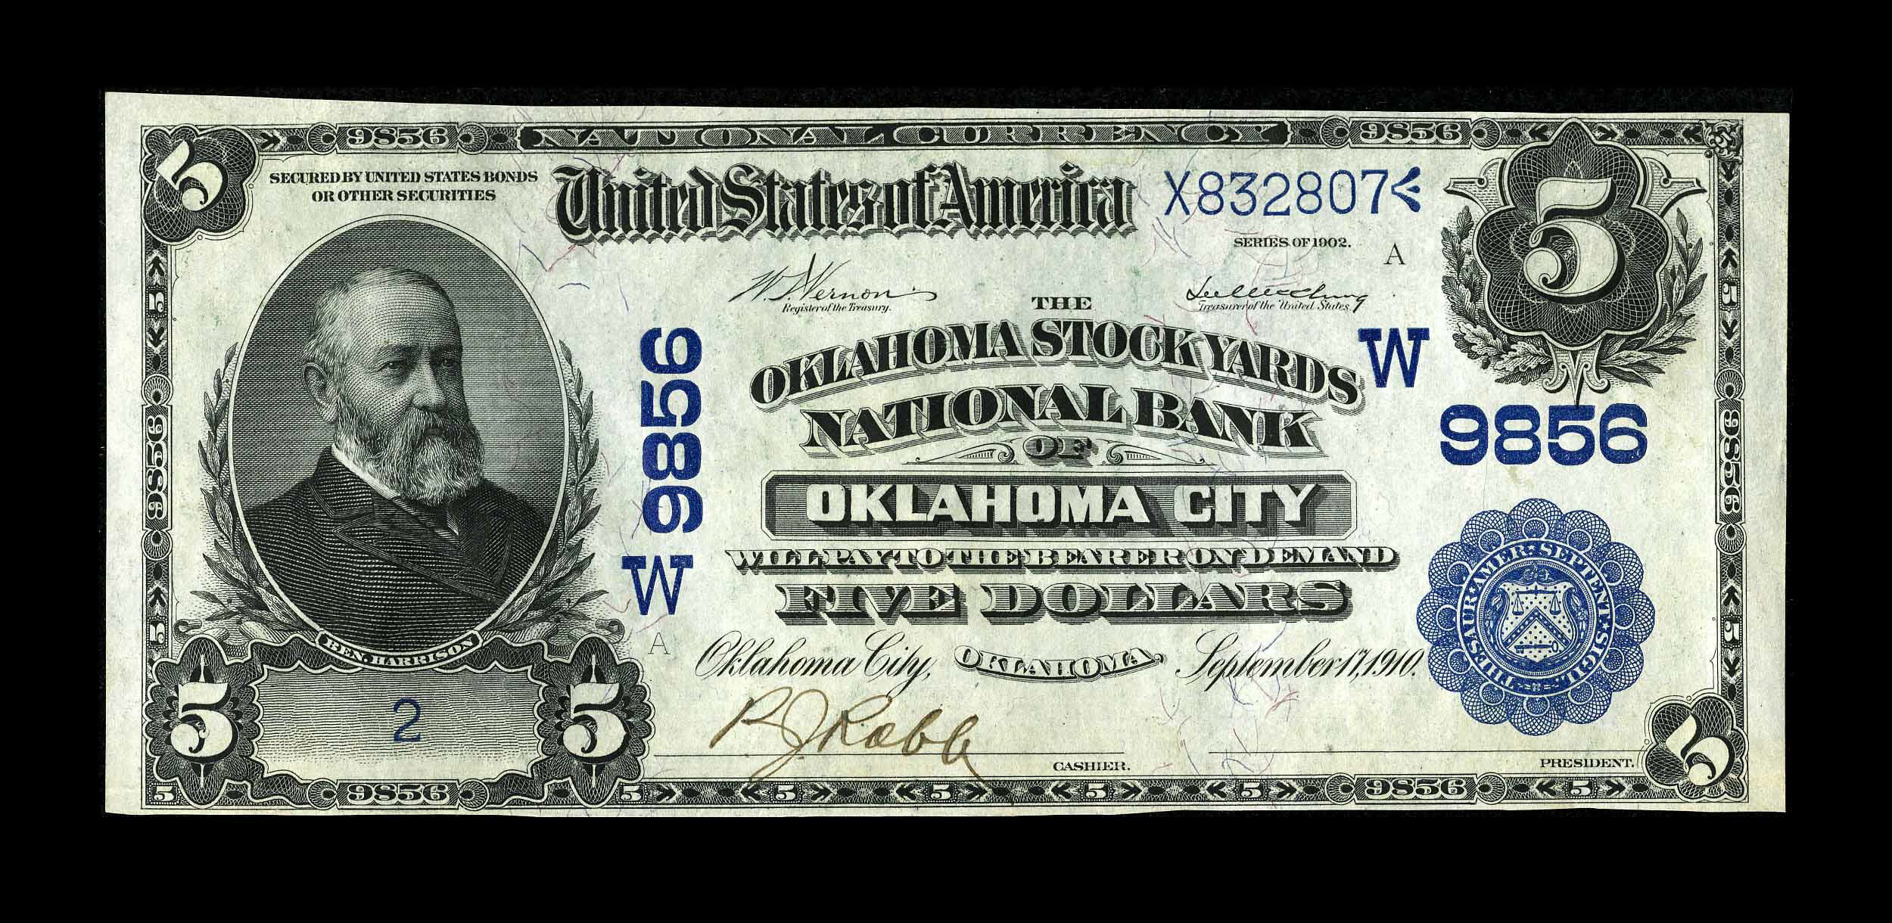
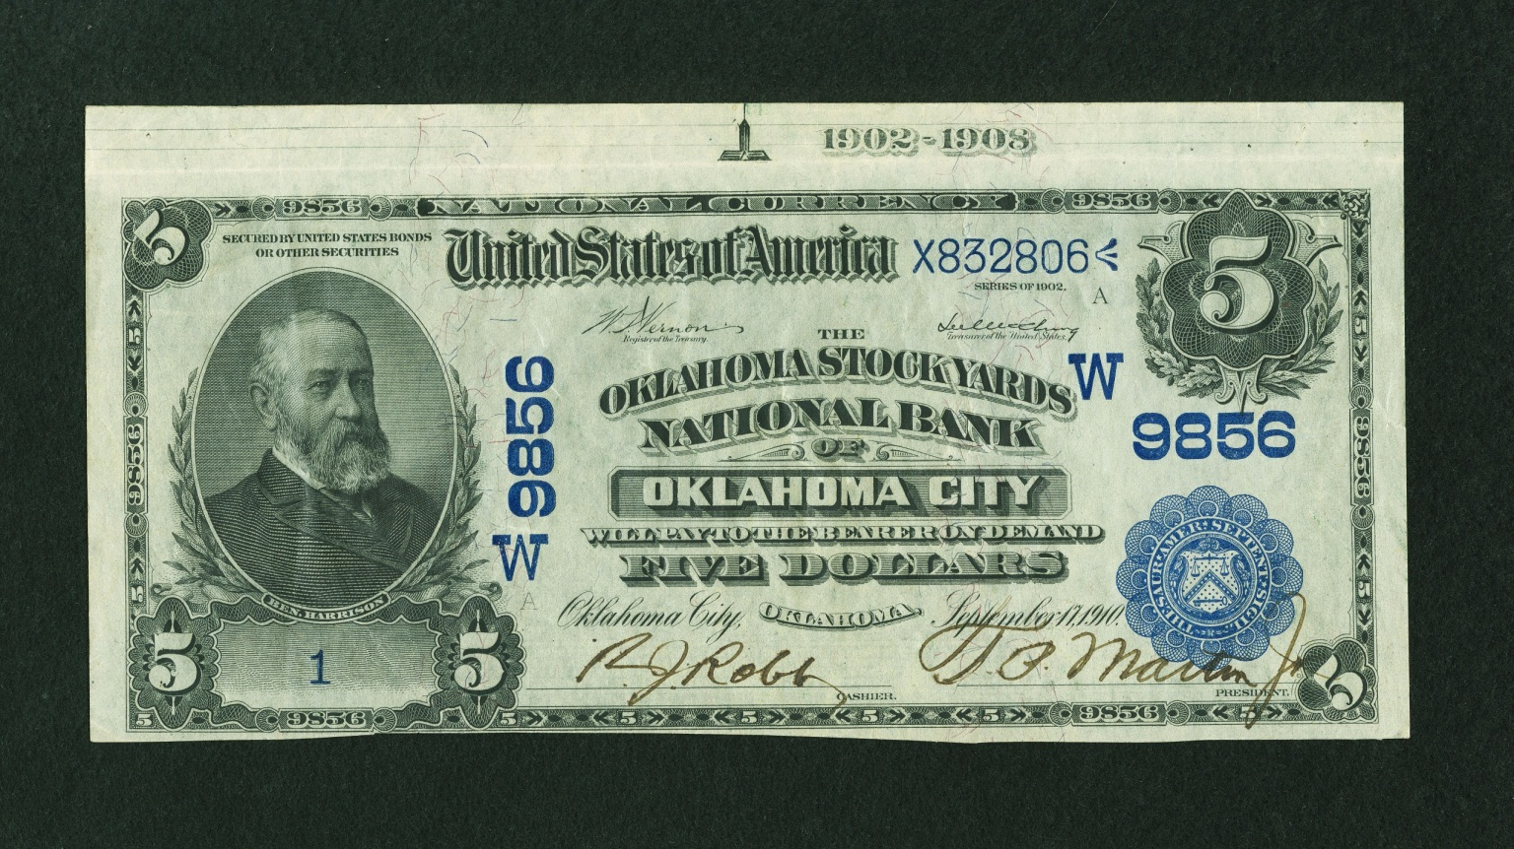

Slide 66
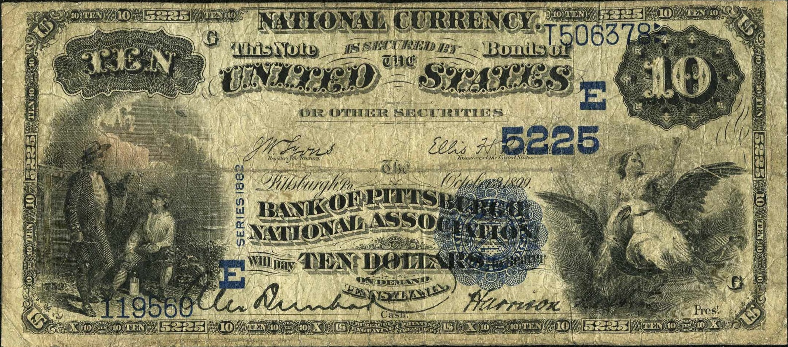
1882 Value Backs
Started in 1915
Therefore, no serial number conditions.

Slide 67
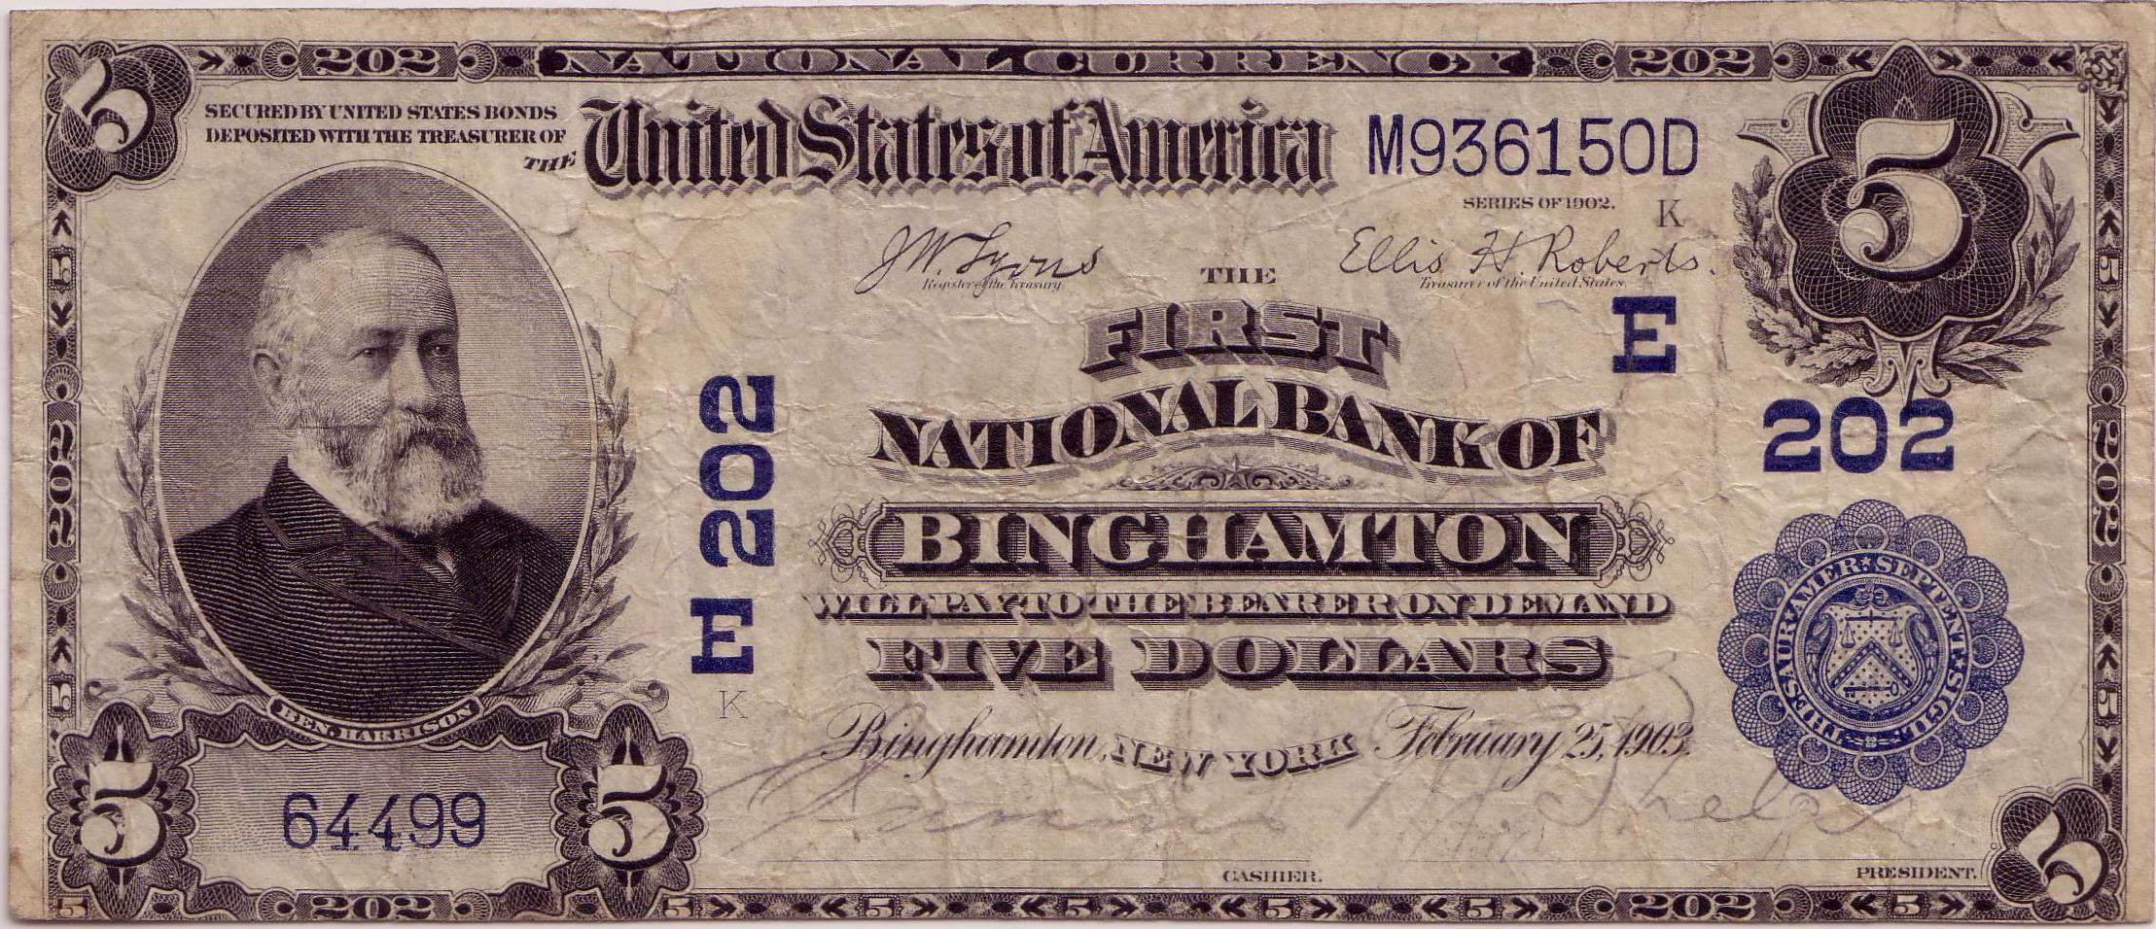
1902 Plain Backs
Started in 1915
Therefore, no serial number conditions.

Slide 68
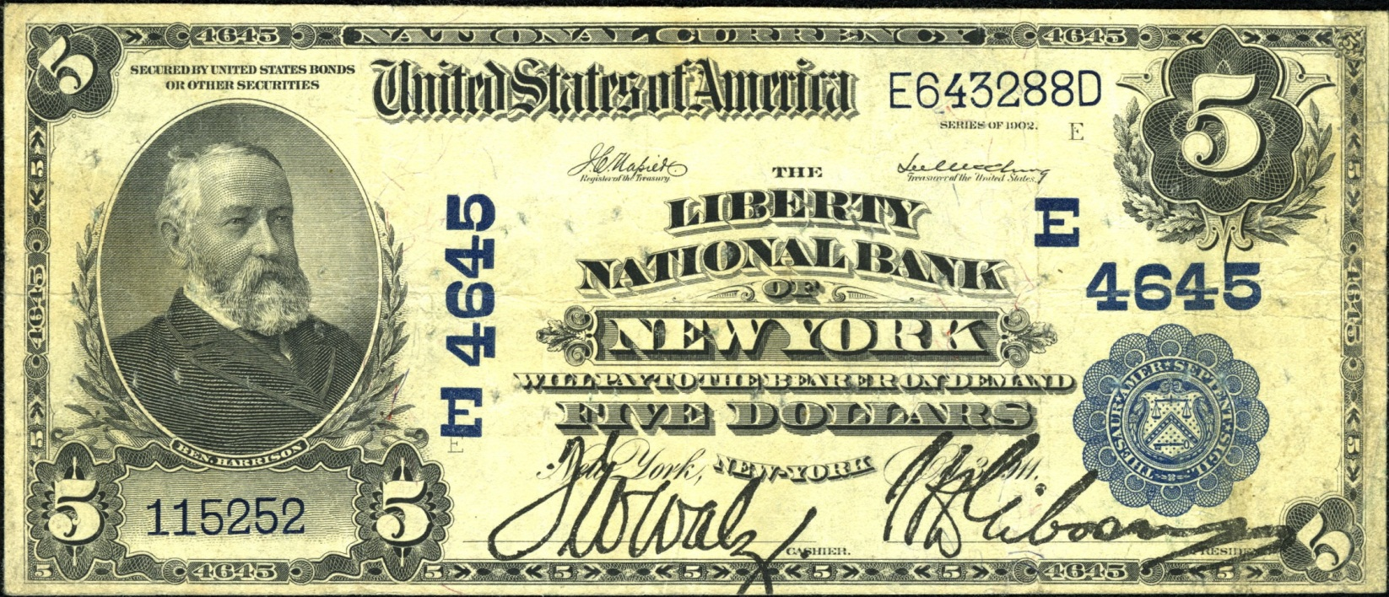
1902 Plain Backs
Something different with fonts on some Plain Backs
Some are “hybrid” with characteristics of old and new

Slide 69
1902 Plain Backs
Latest $5 observed is from V-D Block
Latest $10-$20 observed is from X-D Block
Both produced in 1920

Slide 70
Diagnostics
National bank notes meeting the following criteria are replacement notes printed after the conversion to new style fonts:
The note must have serial numbers of the old style.
The note must be Series of 1882 or Series of 1902.
The Series of 1882 Brown Backs and Series of 1902 Red Seals must have treasury serial numbers greater than the following:
Plate Layout | Brown Backs | Red Seals
5-5-5-5 | H705403H | A530328
10-10-10-10 | all qualify | all qualify
10-10-10-20 | E538996E | B241777
50-100 | B474307 | A92661

Slide 71
Statistics
For the data junkie

Slide 72
LSRNs Documented
All | $5 | $10 | $20 | $50 | $100 | Total
82BB | 8 | 3 | 2 | 0 | 0 | 13
82DB | 3 | 0 | 2 | 0 | 0 | 5
82VB | 1 | 1 | 0 | 0 | 0 | 2
02RS | 28 | 19 | 4 | 0 | 0 | 51
02DB | 10 | 15 | 1 | 2 | 0 | 28
02PB | 9 | 3 | 2 | 0 | 0 | 14
Total | 59 | 41 | 11 | 2 | 0 | 113
Not #1 | $5 | $10 | $20 | $50 | $100 | Total
82BB | 4 | 2 | 2 | 0 | 0 | 8
82DB | 2 | 0 | 2 | 0 | 0 | 4
82VB | 1 | 1 | 0 | 0 | 0 | 2
02RS | 7 | 4 | 0 | 0 | 0 | 11
02DB | 0 | 3 | 1 | 2 | 0 | 6
02PB | 9 | 3 | 2 | 0 | 0 | 14
Total | 23 | 15 | 7 | 2 | 0 | 45

Slide 73
How many are out there?
113 LSRNs observed
About 25% of notes in NBN Census are imaged
Total population among known large size nationals is probably around 450-500 notes.

Slide 74
Inverted Rarity
Rare is common, and common is rare
About 50% of all known replacements are Red Seals
Over 60% of all known replacements are #1 notes
Less than 20% of all known replacements were printed after 1910
About 20% of ALL #1 1902 Red Seals
About 20% of ALL #1 1902 Date Backs

Slide 75
Why so many #1 notes?
First sheet of run
Inadequate inking
Over inking
Alignment problems
Top note in package
Smudged overprinting
Careless handling from BEP to OCC
OCC/BEP did not want the first notes seen by bankers to be deficient

Slide 78
Non-Number One Notes
Survival rate ~ production rate
Ranges between 0.1% and 0.5%
Very similar to 400:1 ratio observed for small size replacements.

Slide 81
Why so few Brown Backs?
Few #1 Brown Backs after 1902
Bank had to be organized before 1902, and…
Add a new denomination to its inventory after 1902, or
Undergo a title change after 1902

Slide 82
What’s Next?
Type Notes!
Notes:
The end…

Slide 83
Non-Star Replacements
Research Pre-1903 LSRNs
Catalog each font
May find some distinction for replacements
Type Notes
1903 – 1910 for Pre-Star Replacements
1914 – 1915 for Pre-Star FRN Replacements

Slide 84
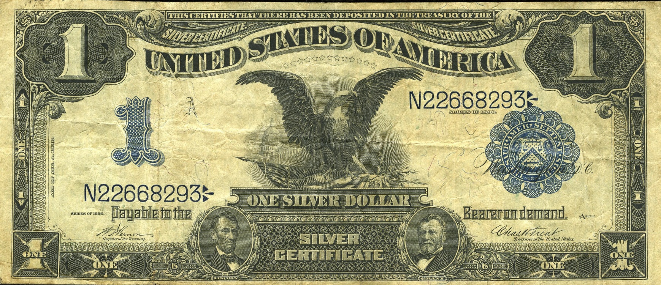
Pre-Star Replacement

Slide 85
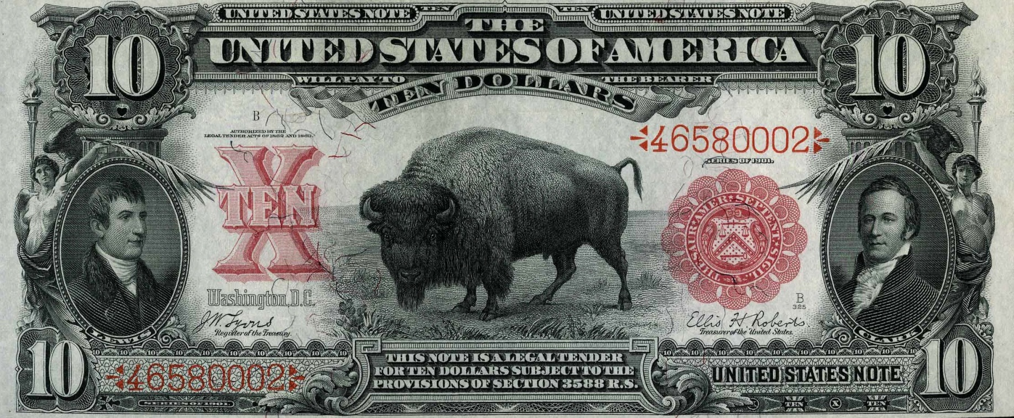
Pre-Star Replacement

Slide 86
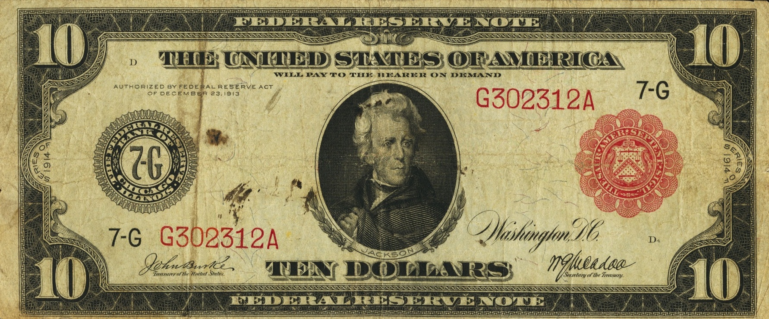
Pre-Star 1914 FRN Replacement

Slide 87
Pre-Star 1914 FRN Replacement

Slide 88
Questions?
Get your handouts before you leave!

Slide 89
The End
References:
Bureau of Engraving and Printing, 1914, Central correspondence files of the Bureau of Engraving and Printing, Record Group 318, locator 450/79/10/5 box 13, national currency, defective: U. S. National Archives, College Park, MD
Google Patents website: http://www.google.com/patents/US155765 (accessed January 1, 2013).
Heritage Auction Archives website: ha.com
Huntoon, Peter. United States Large Size National Bank Notes. Laramie, WY: The Society of Paper Money Collectors, 1995.
Johnson, Frances Benjamin, photographer. “[Women operating machinery at the Bureau of Engraving and Printing]” Photograph. Washington, D.C.: 1889 or 1890. From Library of Congress: Digital Collections. http://www.loc.gov/pictures/item/96501566/ (accessed January 1, 2013).
Johnson, Frances Benjamin, photographer. “Bureau of Engraving and Printing, Wash., D.C.” Photograph. Washington, D.C.: c1889. From Library of Congress: Digital Collections. http://www.loc.gov/pictures/item/96502941/ (accessed January 1, 2013).
Meredith, William M. The Making of Government Securities. Washington, D.C.: Bureau of Engraving and Printing, 1904.
National Currency Foundation website: nbncenus.com
Underwood & Underwood, photographer. “[Woman operating machinery at the Bureau of Engraving and Printing]” Photograph. Washington, D.C.: c1908. From Library of Congress: Digital Collections. http://www.loc.gov/pictures/item/2006692626/ (accessed January 1, 2013).
U.S. Treasury Department, 1903, Annual Report of the Director of the Bureau of Engraving and Printing: U.S. Government Printing Office.

